Slide 1

SUSTAINABLE
DEVELOPMENT GOAL
(SGDs): IMPACT TO
CHILDREN
BY : AMANDA MBIKWANA
“History will be judge by the difference we make
in the everyday lives of children” - Nelson
Mandela

Slide 2

OUTLINE
1. CCEHSA
Ø INTRODUCTION
Ø
Ø
Ø
CCEHSA VISION AND MISSION
CCEHSA STRATEGIC OBJECTIVES
CCEHSA ACHIEVEMENTS
2. SDGs : IMPACT TO CHILDREN
Ø
Ø
Ø
Ø
Ø
Ø
WHY FOCUS ON CHILDREN?
SDGs:
GOAL 2: ZERO HUNGER
GOAL 3: HEALTH & WELL BEING
GOAL 6: CLEAN WATER , SANITATION AND HYGIENE
GOAL 7: AFFORDABLE AND CLEAN ENERGY

Slide 3

OUTLINE
Ø GOAL 12: RESPONSIBLE CONSUMPTION AND PRODUCTION
Ø GOAL 13: CLIMATE CHANGE
Ø GOAL 14&15: LIFE BELOW WATER AND LIFE ON LAND
Ø CONCLUSION

Slide 4
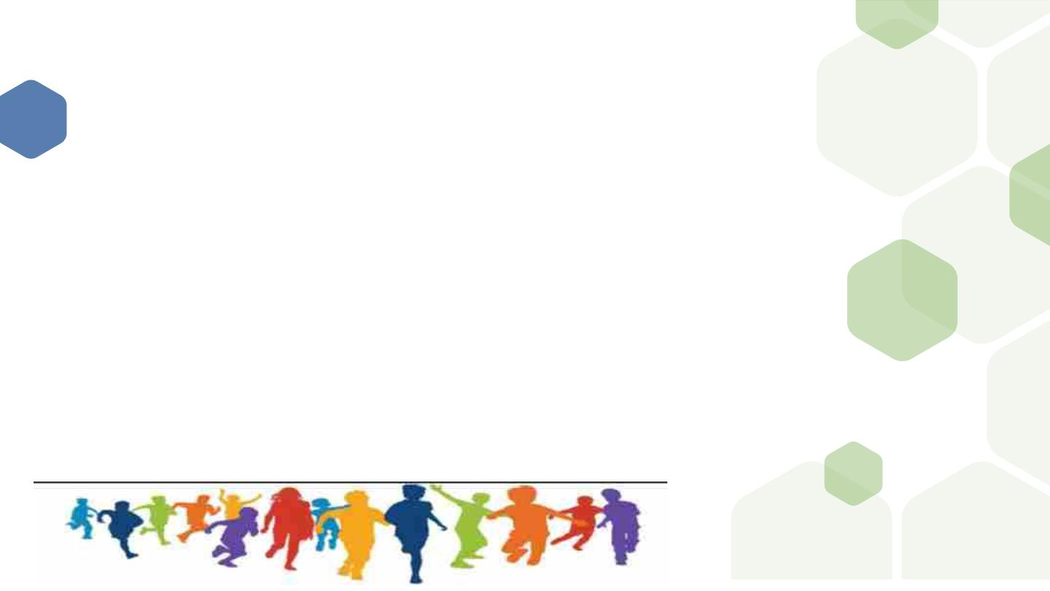
CCEHSA
v CCEHSA – a Nonprofit Organization established in 2020, registration number: 246-772 NPO
v The organisation caters for ALL children of Southern Africa especially the disadvantaged
between the ages of 0-18 in order to bring positive change in their lives by improving their
health through providing a platform for engagements and strategy development on
environmental health challenges faced by children in the society
v CCEHSA through partnership with several interested parties, seeks to change the current
existing children’s environmental health governance gap
v CCEHSA aims to accelerate and amplify environmental health knowledge and practices that
affects the children of South Africa
v Investing in children's health through promoting awareness on healthy environments for
children
v CCEHSA aims to reduce ill-health caused by Environmental factors amongst children, and to
promote literature about children’s environmental health
4

Slide 5

CCEHSA
Founding members/Board Members :
Mrs. Amanda Mbikwana- Chairperson
Mr Sifiso Mbele- Deputy Chair
Ms. Junior Tsela- Treasurer
Ms. Thero Marule- Board Secretary
Mr Joe Shikwambane- Strategy and Policy
Ms. Nomsa Thabethe- Advisory committee- Science and Research
Advisory Council Member:
Dr. Samantha Lange- Training and Development
CEH Zimbabwe and Namibia Coordinator:
Mr. Stephen Musarapasi
Provincial coordinators
Mr Danie Stander-NC
Ms Esther Mahlalela-MP
Ms Lindiwe Dhlodhlo-KZN
Ms. Andiswa Nqezo-EC
5

Slide 6
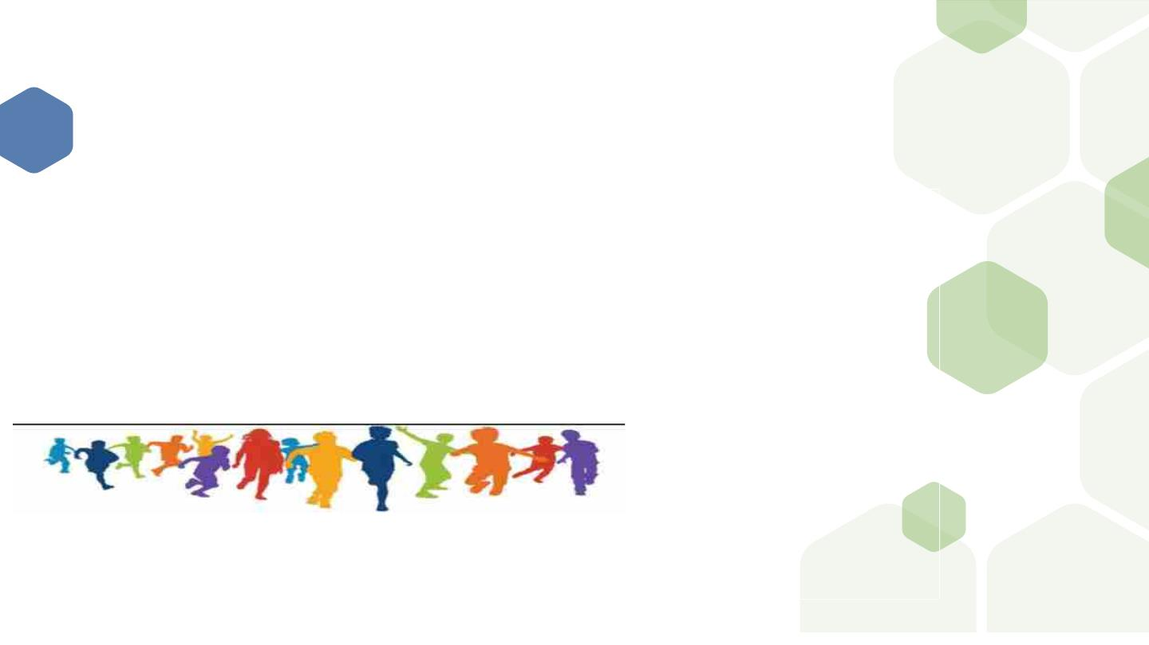
CCEHSA VISON AND MISSION
⬢ VISION:
⬢ MISSION:
⬢
To be a leading Centre of excellence in the Southern African
Development Community (SADC) region where fundamental
children’s environmental health rights are prioritized, realised
and achieved
⬢
To provide a platform for strategic development
of children’s environmental health in Southern
Africa

Slide 7
CCEHSA STRATEGIC
v Promote research in children’
Environmental Health
v Fundraising to enable advocacy and
promotion of our strategic objectives
v Establish an effective communication
platform to promote CCEHSA with all
identified stakeholders
v Promote the concept and knowledge of
children’s environmental health
matters amongst EHP’s
v Advocate for Children’s Environmental
health to be included in curricula
v Promote knowledge by Early Childhood
Developmental Centers and Schools on
children’s environmental health matters
v Establish partnerships with relevant
stakeholders
v Identify Provincial coordinators to facilitate our work in
all provinces
v Identify coordinators in neighbouring countries/Southern
Africa

Slide 8
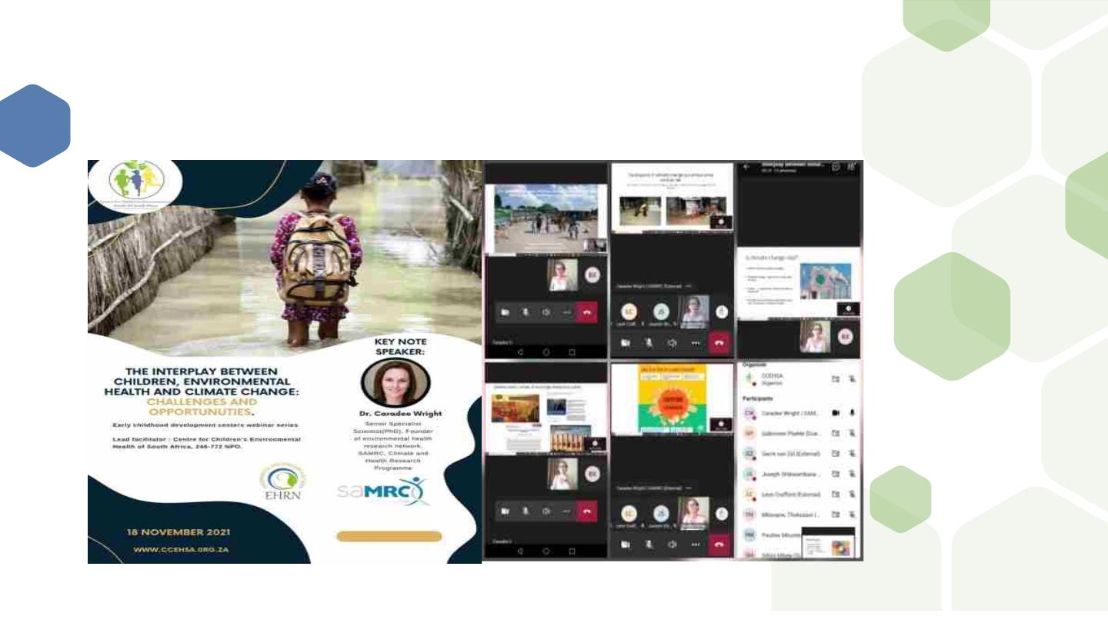
CCEHSA ACHIEVEMENTS:
8

Slide 9
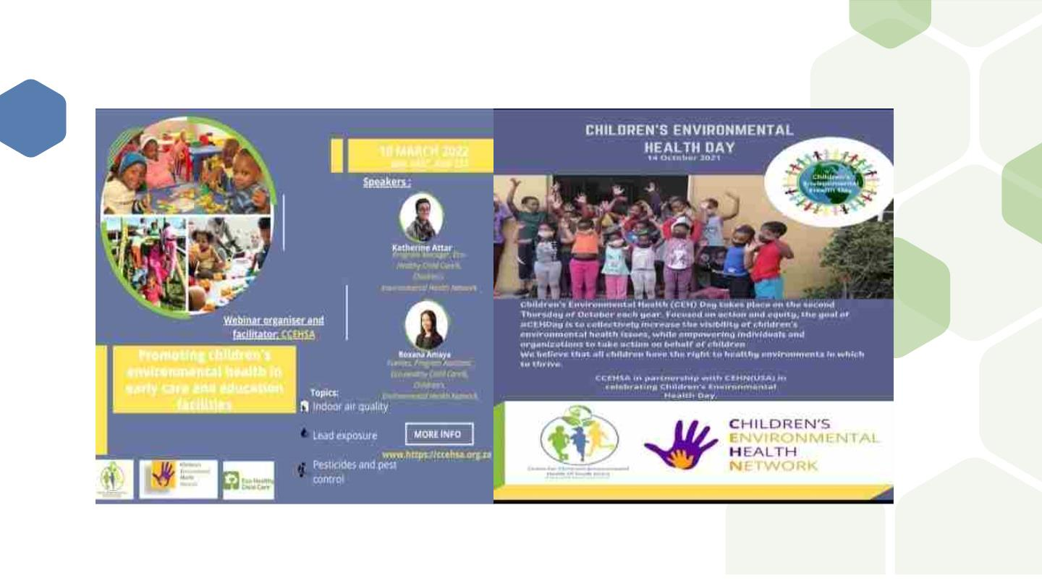
CCEHSA ACHIVEMENTS:

Slide 10
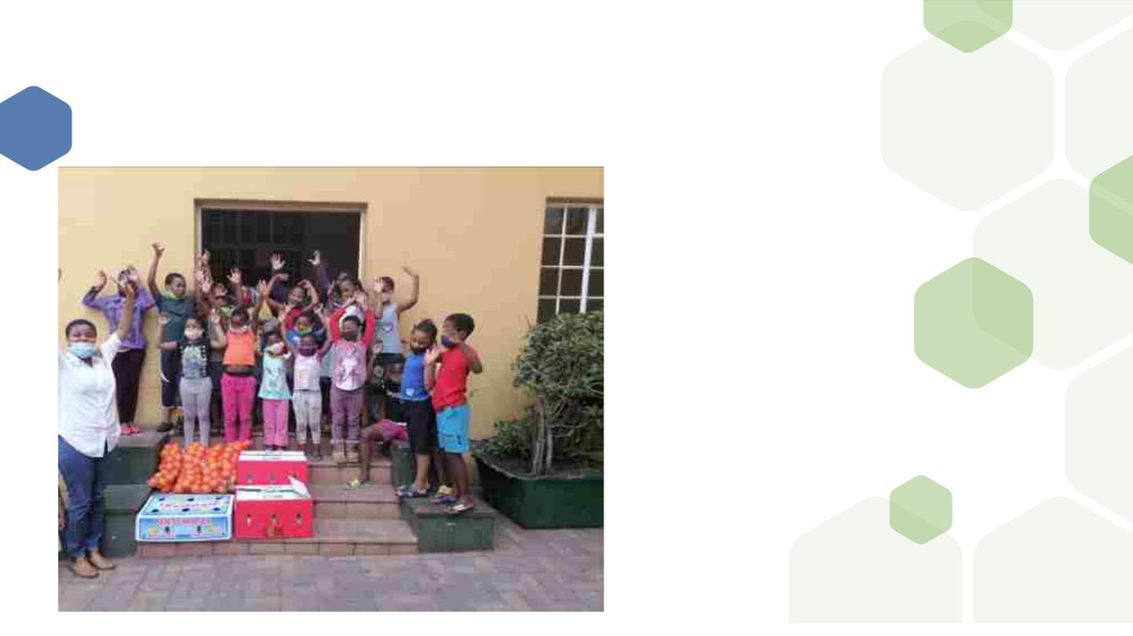
CCEHSA ACHIEVEMENTS:

Slide 11
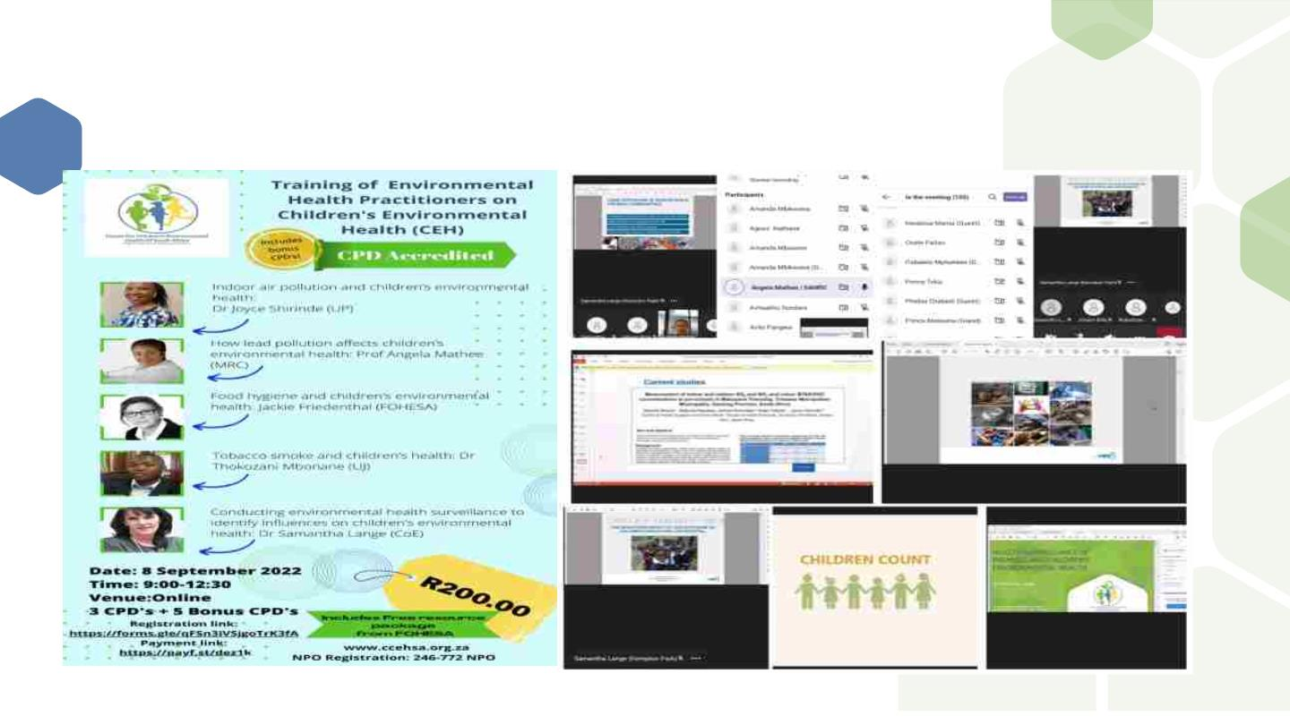
ACHIEVEMENTS:

Slide 12
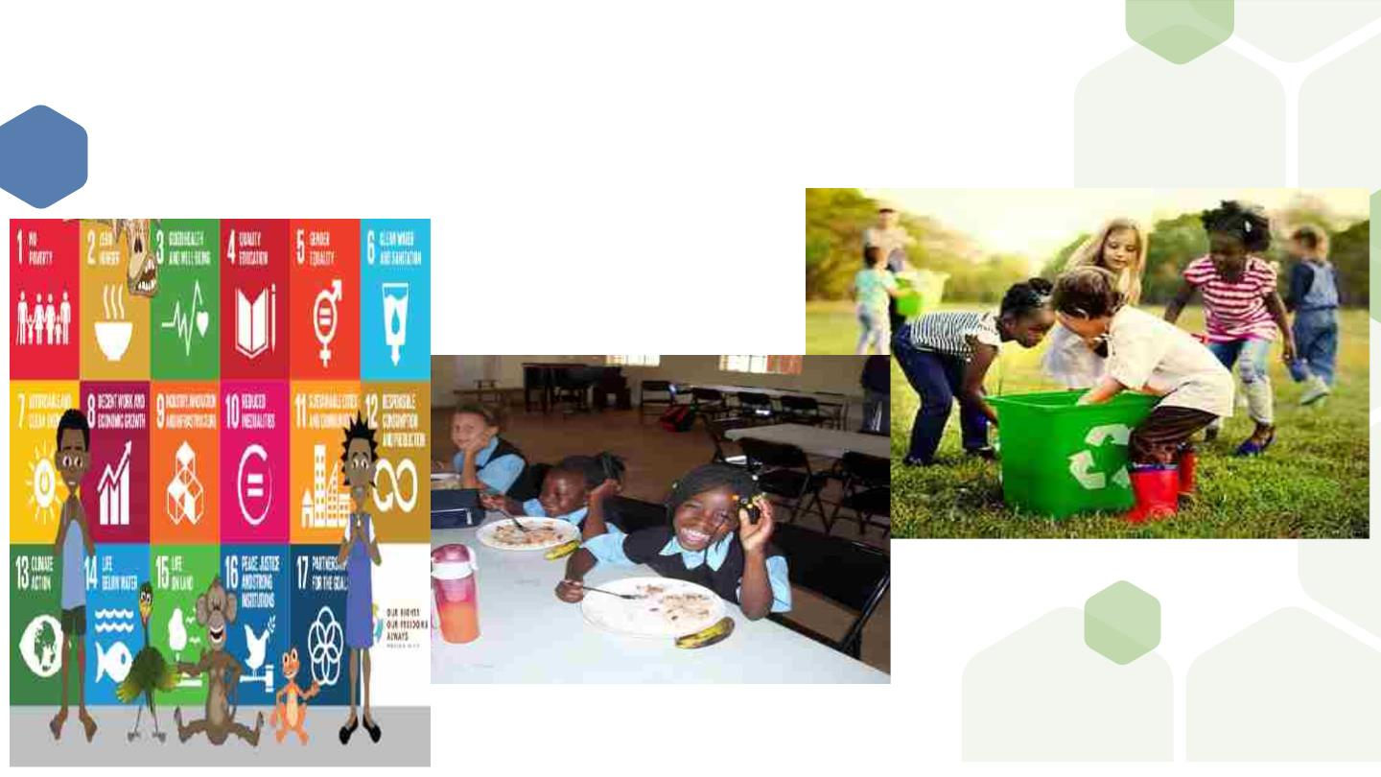
SDGs: IMPACTS TO CHILDREN

Slide 13
WHY THE FOCUS ON CHILDREN?
v The environment thus represents a major factor in children’s health, with effects seen in every part of
the world
v The key to a peaceful, prosperous, and sustainable world is healthy, safe, and empowered children
v Children are vulnerable to environmental risks ,creating a safe and healthy environment is one of the
essential elements for improving child survival, helping children to thrive, and achieving health equity
v Global estimates suggest that 26% of all childhood deaths, and a quarter of the disease burden in
children aged under five, could be prevented by removing modifiable environmental risks
v The disease burden linked to the environment also tends to be higher in low- and middle-income
countries
v The United Nations (UN) Sustainable Development Goals (SDGs) encourages an intersectoral approach
to resolve the shortcomings of health goals in the Millennium Development Goals and the emerging
environmental health challenges
v SDGs provide strong guidance for governments around the world, to monitor and assess their progress
towards creating healthier environments for children
v The goals target several environmental health risk factors and provide the indicators to measure their
status and progress towards reducing these risks

Slide 14
PROGRESS FOR EVERY CHILD IN THE
SDG ERA. UNICEF : 2019
v The SDGs are universal in scope, their call to leave no one behind puts the world’s
most vulnerable and marginalized people, including children – at the top of the
2030 Agenda
v But four years since world leaders committed to achieving the SDGs, are we on
track to achieve the goals for children? Do we have enough information to know?

Slide 15
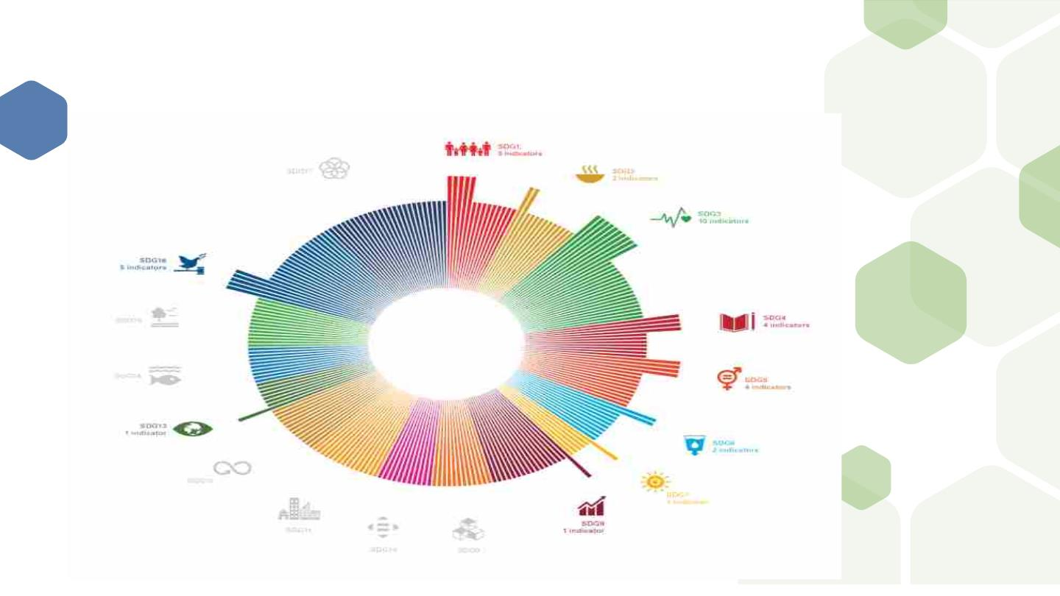
44 CHILD RELATED
INDICATORS.UNICEF:2019

Slide 16
INDICATORS ARRANGED INTO 5
DIMENSIONS OF CHILD
RIGHT.UNICEF, 2019
v Every child survives and thrives
v Every child learns
v Every child is protected from violence, exploitation and harmful
practices
v Every child leaves in a safe and clean environment
v Every child has a fair chance in life

Slide 17
GOAL 2: ZERO HUNGER
v The triple burden of malnutrition – undernutrition, hidden hunger
and overweight – threatens the survival, growth and development of
children
v The greatest burden of all forms of malnutrition is shouldered by
children and young people from the poorest and most marginalized
communities

Slide 18
SDG 3:HEALTH AND WELLBEING
vReproductive and children’s health are cornerstones of Goal 3
vMaternal, prenatal and early childhood periods are particularly vulnerable life
stages where environmental hazards can result in premature births and other
pregnancy complications, lifelong diseases
vIn 2015, a reported 26% of the deaths of 5.9 million children who died before
the age of five could have been prevented by addressing environmental risks
and hazards
v Another major children’s environmental health concern is malnutrition,
increases the frequency and severity of common infections in children and
delays recovery time, leads to stunted growth

Slide 19
SDG 6: CLEAN WATER, SANITATION
AND HYGIENE
v Young children are particularly vulnerable, and water and sanitation related
diseases remain among the leading causes of death in children under five as
well as contribute malnutrition and stunting
v Without safe toilets , taps and soap for hand washing, diseases spread rapidly
and newborn babies risk death from infection
v Every year, 297,000 children under 5 years die due to diarrhea linked to
inadequate WASH.
v Improving equitable access to water, therefore, underpins the success of all
SDGs

Slide 20
SDG 7: AFFORDABLE AND CLEAN
ENERGY
v Sustainable energy is a critical enabler and dramatically improves the
quality, accessibility and reliability of services that children rely on for
their survival and well-being
v The use of biomass fuel is a major source of household air pollution,
but access to clean fuels and technologies for cooking and heating can
reduce the mortality rate attributed to household air pollution

Slide 21
SDG 12: RESPONSIBLE
CONSUMPTION AND PRODUCTION
v SDG 12 relates to children in two critical ways:
1. Unsustainable and unsafe consumption and production patterns lead to
toxic waste and limited resources which unduly harms children’s health,
development and environments.
2. Years of evidence show that widespread changes in positive societal
behavior often begin with children becoming aware of the problems
they observe in their own communities.

Slide 22
SDG 13: CLIMATE CHANGE
v Climate change and environmental degradation are equity issues that
undermine the rights of every child especially the most disadvantages
v Approximately 1 billion children are at an 'extremely high risk' of the
impacts of the climate crisis.
v These children experience multiple climate shocks combined with poor
essential services such as water, sanitation and healthcare.
v As climate change disrupts the environment, children are being forced
to grow up in a world that threatens their health, nutrition, education,
development, survival and future

Slide 23
SGD 14&15:LIFE BELOW WATER &
LIFE ON LAND
v Children have a right to natural world ,Protecting life below water
(SDG 14) and life on land (SDG 15) matters greatly for the health and
wellbeing of children now, as well as future generations.
v Children rely on land and marine resources for access to safe water,
food and air

Slide 24
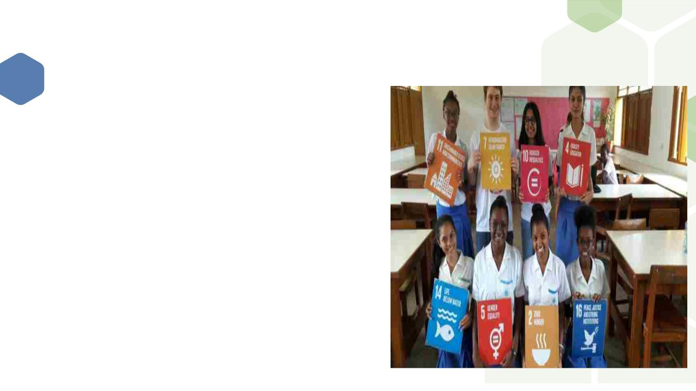
HOW CCEHSA CAN PLAY A ROLE IN
THE IMPLEMENTATION OF SDGs?
v To build and enhance partnerships with diverse stakeholders to
strengthen the means of implementation
v SDG awareness building and meaningful participation of children,
adolescent and youth to spark action in their communities and
holding leaders accountable
v To plan and implement programs on SDGs that are directly related
to children to illustrates the powerful ways in how reaching
children with education in schools positively impacts household
and community practices
v Encourages governments to improve climate education, awareness
and participation especially among children and adolescents as this
will lead to sustainable personal behavior changes including
through household energy use, transportation and food choices,
recycling and waste reduction behaviors and other climate friendly
decision

Slide 25
CONCLUSION
v The SDGs cannot be achieved without the realisation of child rights. As world leaders work
to deliver on the 2030 promise children around the globe are standing up to secure their right
to good health, quality education, a clean planet and more
v The leaders of tomorrow, children’s ability to protect the future for us all depends on what
we do to secure their rights today
v The capacity of nations to grow, innovate, and strengthen depends on a healthy and
productive population. Therefore, the large number of children starting life at severe risk
threatens all other Sustainable Development Goals.
v Environmental health risks to children and the SDGs and these connections require explicit
attention in policies and planned actions to Ensure healthy lives and promote wellbeing for
all at all ages moving forward

Slide 26

26

