Slide 1
Specialization in Environmental Health in relation to Sustainable Development Goals
Dr Samantha Lange
Professional Board for Environmental Health Practitioners

Slide 2
What is the purpose of HPCSA?
Guiding the profession and protecting the public
Profession
Public
Training and development
Ethical guidance
Guidance with respect to scope of professions and practice
Continuous professional development
Accessible and equitable healthcare services including primary Health Care
Healthy lifestyle
Improved life expectancy
Protection from misconduct and misrepresentation
Access to qualified personnel
HPCSA Council, Professional Boards and Secretariat

Slide 3
How is this done? HEALTH PROFESSIONS ACT 56 OF 1974
Sections 17 & 34: Registration a prerequisite for practicing
Section 19: Removal of name from, & restoration to register
Section 19A:
Suspension of health professionals &
revocation of such suspension
Section 26: Compliance with certain conditions relating to
Continuing Professional Development
Section 16: Control over training (education)
Section 33: Definition of scope of health professions
Section 51: Regulation relating to investigations in respect of impaired persons
For Practitioners

Slide 4
Protecting the public
Accepting complaints regarding practitioners
Investigating complaints guided by HPCSA Ethical Rules
Impose a penalty Regulation 4(9) where necessary

Slide 5
What is specialisation?
DEFINED BY THE CAMBRIDGE DICTIONARY AS:
a particular area of knowledge or the process of becoming an expert in a particular area:
Specialization (= limiting study or work to one particular area) usually doesn't occur until PhD level.

Slide 6
HOW DOES SPECIALISATION WORK IN THE HEALTH FIELD?
A health professional acquires a basic professional qualification
The professional applies to a learning institution/university to complete a post graduate course in their field of specialization (between 3-5 years)
Whilst studying the health professional normally practices within the field of specialistion in a health care institution linked to the learning institution (eg, a doctor working at a hospital while completing the course with a university)
A specific curriculum is followed and monitored by the learning institution and the healthcare institution
Question:
What is the current scenario for Environmental Health?

Slide 7
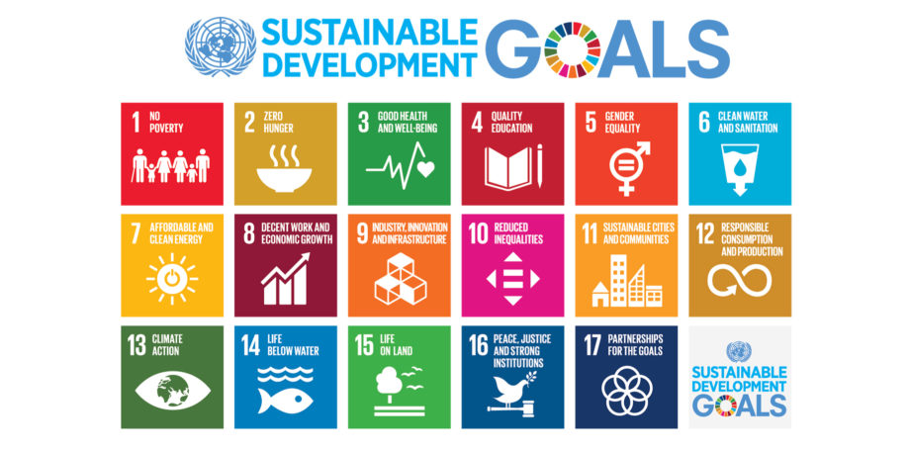
Sustainable development goals 2030

Slide 8
How can specialization help to achieve sdg’s?
SDG 3: Ensure healthy lives and promote well-being for all at all ages (eg. Specialisation in epidemiology)
SDG 6: Ensure availability and sustainable management of water and sanitation for all ( eg. Specialization in water technologies)
SDG 7: Affordable and clean energy (eg.Specialisation in Air Pollution)
SDG 11: Make cities and human settlements inclusive, safe, resilient and sustainable
SDG 13: Take urgent action to combat climate change and its impacts
SDG 14: Conserve and sustainably use the oceans, seas and marine resources for sustainable development (eg.Specialisation in ecology)
SDG 15: Protect, restore and promote sustainable use of terrestrial ecosystems, sustainably manage forests, combat desertification, and halt and reverse land degradation and halt biodiversity loss

Slide 9
What needs to happen?
A cost and needs analysis should be conducted to determine which critical areas which could become specilizations (National Health)
Learning institutions need to be consulted to develop an appropriate curriculum
Industry needs to be consulted to invest in and provide access for specialization
Legislation should be reviewed to provide for specializaton

Slide 10
What is the PBEHP position on specialization?
The Board recognizes that although there is always a critical place for a general practitioner in the form of an EHP there are certain spaces/scenarios which could call for specialist practitioners in order to affect the change need especially in regard to achieving SDG’s.
Inputs have been made by the Board regarding the regulation of specialization within the proposed new Environmental Health Act
The Board and HPCSA will always prioritize the protection of the public and the maintenance of professional standards

