Slide 1
1
Briefing session: HP16-2024EPI/01
Ms E Nyathi
14 April 2023

Slide 2
2
Contract dates
Closing date:
HP16-2024EPI/01– 08 May 2023
Contract Period:
HP16-2024EPI/01 - 1 January 2024 to 31 December 2026
HP tenders' advertisement platforms
  Available on NDoH website
  www.health.gov.za
  |Tenders| View Pharmaceutical Tenders
  Available on National Treasury Website
  www.treasury.gov.za
  e-tenders

Slide 3
3
Tender Documents
  Four documents must be downloaded per tender and saved:
    Bid pack
    2) Bid Response Document (in Excel)
    3) Annexure A – Checklist (in Excel)
    PBD9 Directors Categorisation Profile (in Excel and must be completed)
    Note: Its compulsory to submit certified copies of Director’s identification

Slide 4
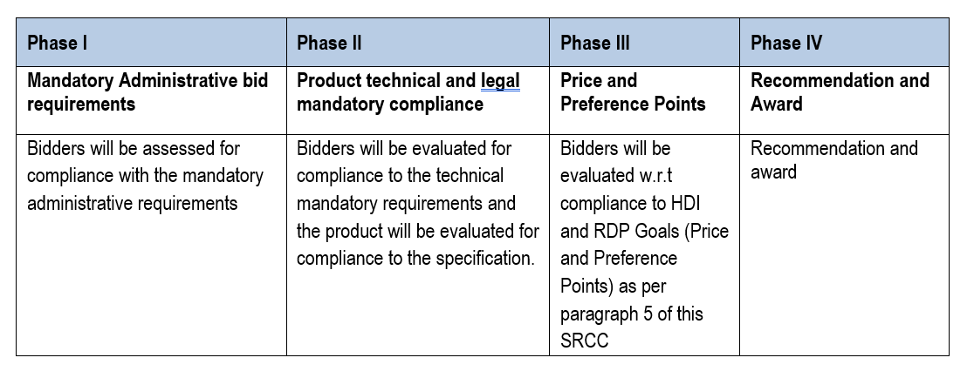
4
Evaluation Criteria
Phases of evaluation

Slide 5
5
Administrative requirements (Phase I evaluation)
Registration on the Central Supplier Database (CSD)
Submission of Tax Clearance pin
    Bidders should be Tax compliant at time of the evaluation.
    All companies within a joint venture should be Tax compliant at time of the evaluation.
All bid documents listed in the Bid Document Checklist (Annex A), must be included in the bid and presented in the exact sequence as per checklist. (marked with tabs)
Notes:
Bidders are required to be registered on the CSD managed by National Treasury. The National Department of Health shall verify the bidder’s tax compliance status through the CSD.
Bidders are required to submit a Tax Clearance pin, issued by the South African Revenue Services (SARS).

Slide 6
6
Legislative requirements (Phase II evaluation)
The bidder offering a product must be the holder of a licence to manufacture medicines issued in terms of section 22C (1)(b) of the Medicines and Related Substances Act, 1965 (Act 101 of 1965), as amended.
In case of a joint venture all companies in the agreement must supply their licence to manufacture medicines issued in terms of section 22C (1)(b) of the Medicines and Related Substances Act, 1965 (Act 101 of 1965), as amended.
A certified copy of the original license must be submitted by the bidder offering the product.

Slide 7
7
Legislative requirements (Phase II evaluation) cont…
Items offered must be registered in terms of section 15 of the Medicines and Related Substances Act, (Act 101 of 1965), and must comply with the conditions of registration for the duration of the contract.
A certified copy of the Medicine Registration Certificate (MRC) including annexures (Conditions of Registration), must be included with the bid for all items offered.
The bidder must be indicated as the applicant on the MRC
In a Joint Venture (JV), one of the companies in the JV must be indicated as the applicant on MRC.
All companies in the JV must be the holder of the license to manufacture or import medicines
Inclusive of any valid variation summaries approved by SAPHRA for amendments on the Medicine Registration Certificate. Note: (Both MRC and relevant variation summary must be submitted)

Slide 8
8
Sample submission and product technical compliance (Phase II evaluation)
All bidders are required to submit samples including bidders who are currently supplying the NDoH with products to confirm the following:
Compliance with specifications as set out in the bid document/ item specification.
Compliance of the product with the requirements of the Medicines and Related Substances Act, (Act 101 of 1965)
Samples must be submitted to both Health Facilities as indicated in the SRCC, before bid closure.
No samples must be sent to the National Department of Health.

Slide 9
9
PREFERENCE POINTS
New Preferential Procurement Regulations (the 2022 Regulations) were gazetted on 4 November 2022 (effective 16 January 2023) and Preference Points will be allocated according to these new regulations.
The 2022 Regulations requires a tender to indicate the preference point system that will applied i.e 80/20 or 90/10;
Furthermore the 2022 Regulations introduced HDI & RDP specific goals for which points may be awarded and the Promotion of specific Reconstruction and Development Programme (RDP) goals in the public procurement environment:
(specific goals as contemplated in section 2(1)(d) of the Preferential Procurement Policy Framework Act, 2000 (Act No. 5 of 2000).

Slide 10
10
PREFERENCE POINTS
(Phase III continued.)
Specific goals as contemplated in section 2(1)(d) of the Preferential Procurement Policy Framework Act, 2000 (Act No. 5 of 2000) may include:
HDI - contracting with persons, or categories of persons, historically disadvantaged by unfair discrimination on the basis of race, gender and disability
RDP - including the promotion and implementation of programmes of the Reconstruction and Development Programme goals in the public procurement environment (as published in Government Gazette No. 16085 dated 23 November 1994).

Slide 11
11
PREFERENCE POINTS (Phase III continued.)
Furthermore “specific goals” contemplated in PPPFA may include
HDI (as referenced in 2022 Regulations)
“contracting with persons, or categories of persons, historically disadvantaged by unfair discrimination on the basis of race, gender and disability “
Therefore, preference points are allocated aligned with % HDI ownership
RDP (as referenced in 2022 Regulations)
“including the implementation of programmes of the Reconstruction and Development Programme as published in Government Gazette No. 16085 dated 23 November 1994” i.e. (NDoH selected goal) The promotion of South African owned enterprises (points allocation aligned with ownership).

Slide 12
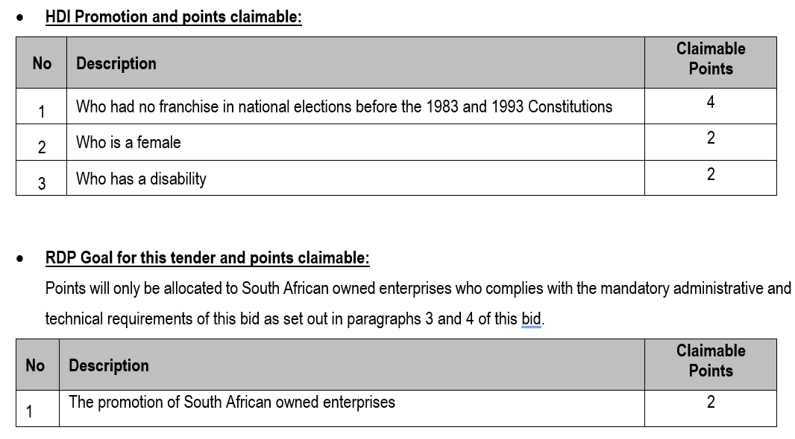
HDI AND RDP GOAL POINTS

Slide 13
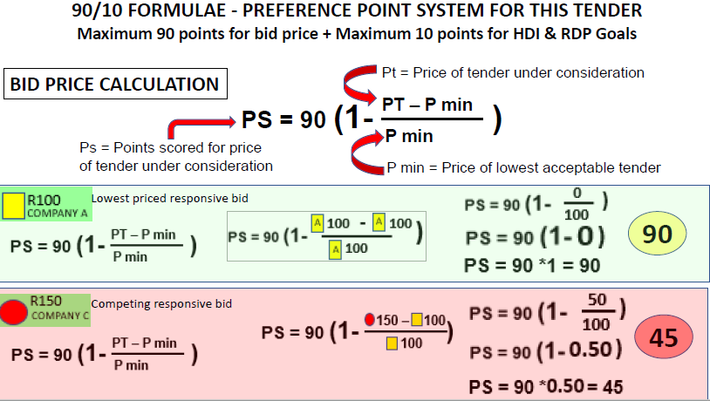
HDI AND RDP POINTS CALCULATION

Slide 14
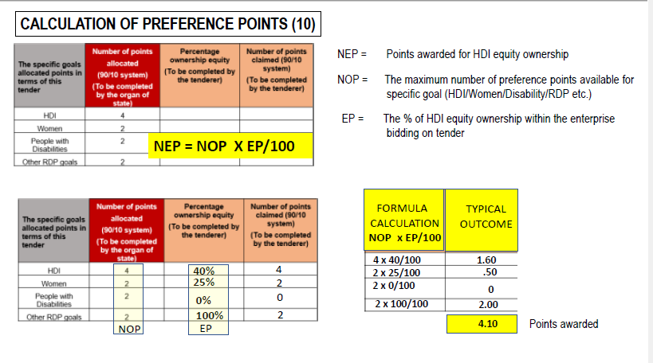
HDI AND RDP POINTS CALCULATION

Slide 15
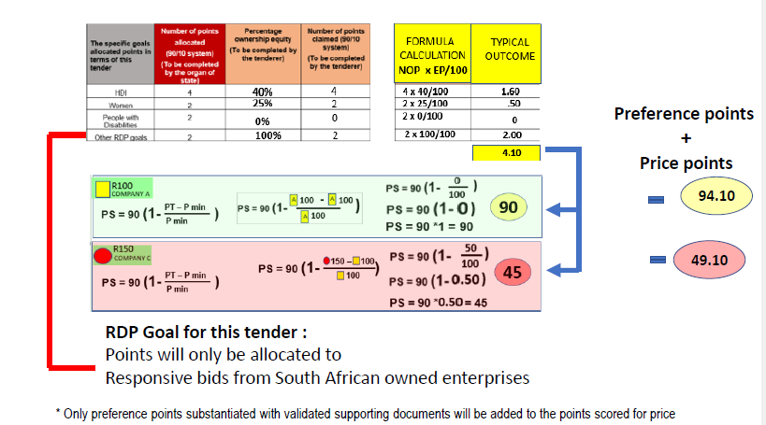
HDI AND RDP POINTS CALCULATION

Slide 16

OTHER CLAIMS: (SRCC)
Equity claims for a Trust may only be allowed in respect of those persons who are both trustees and beneficiaries and who are actively involved in the management of the Trust.
A Consortium if a Joint Venture may, based on the percentage of the contract value managed or executed by their HDI members, be entitled to equity ownership in respect of HDI.
The number of points scored for a Consortium or a Joint Venture must be added to the number of points scored for achieving a specified goal.

Slide 17



17
The centralised toll-free corruption hotline - 0800 701 701
Read more: http://www.southafrica.info/services/government/hotline-anticorruption.htm#.Vekno0YbJzA#ixzz3kkAPmrmo

Slide 18
18
Thank You
  Thank you for attending this Online Briefing Session
  The End
  Question can be emailed to
  tenders@health.gov.za

