Slide 1
1
Briefing session: HP03-2023CHM/01, HP11-2023LVP/01 and HP13-2022ARV/01
Ms E Nyathi & Mr J Du Preez & Ms A Willemse & Ms B Stevens
3 November 2023

Slide 2
2
Contract dates
Closing date:
HP03-2023CHM/01, HP11-2023LVP/01 and HP13-2022ARV/01 – 27 November 2023
Contract Period:
HP03-2023CHM/01 – ending 30 September 2026
HP11-2023LVP/01 - ending 30 September 2026
HP13-2022ARV/01 – ending 30 June 2025
HP tenders' advertisement platforms
  Available on NDoH website
  www.health.gov.za
  |Tenders| View Pharmaceutical Tenders
  Available on National Treasury Website
  www.treasury.gov.za
  e-tenders

Slide 3
3
Tender Documents
  Four documents must be downloaded per tender and saved:
    Bid pack
    2) Bid Response Document (in Excel)
    3) Annexure A – Checklist (in Excel)
    PBD9 Directors Categorisation Profile (in Excel and must be completed)
    Note: Its compulsory to submit certified copies of Director’s/Owners identification

Slide 4
4
Submission of bid documents
Submit 3 sets of your bid
    Set 1: Hard copy of Bid (constitutes the legal binding bid document)
      ALL PAGES MUST BE INITIALLED BY SIGNATORY USING INK & ALL RELEVANT DOCUMENTS MUST BE CERTIFIED INCLUSIVE OF CERTIFICATION DATE
      Present your bid bound with Tabs same as bid file Index.
Notes:
All SBD, PBD and Bid Response forms fully completed and printed, signed where indicated.
Remaining entry fields completed clearly in black ink, handwritten in capital letters.

Slide 5
5
Submission of bid documents
Document Submission
    Set 2: Scanned image of set 1 (i.e. A folder with all completed, signed documents (files), therefore scanned documents are presented as separate files in sequence (as per bid file Index). Each file named as per bid file Index.
    Set 3: Electronic version of bid
      Completed Bid Response Document in Excel (not PDF)
      PBD9 Directors Categorisation Profile
      Annexure A Checklist
  Set 2 and Set 3 must be included on a Universal Serial Bus (USB) Flash Drive / Storage Device and submitted in a sealed package with Set 1.
  The full name and address of the bidder, including the return address of the bidder, the bid number and the closing date of the bid must be clearly indicated on the package.

Slide 6
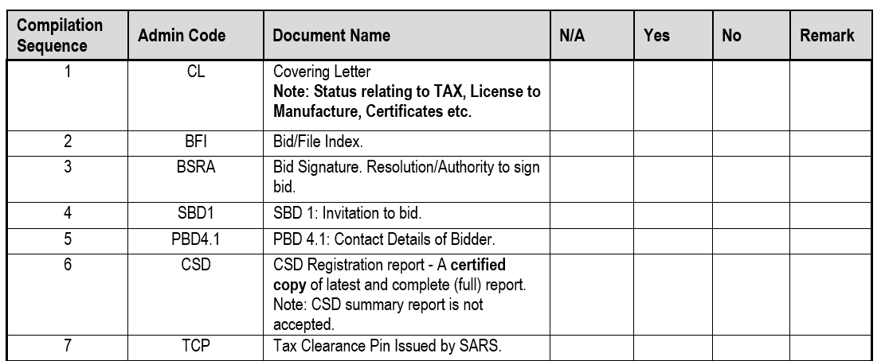
6
Submission of bid documents
All bid documents must be bound in a single file, with Tabs same as Index.
Index: All fields must be completed.
Where information requested is not relevant this should be indicated as N/A.

Slide 7
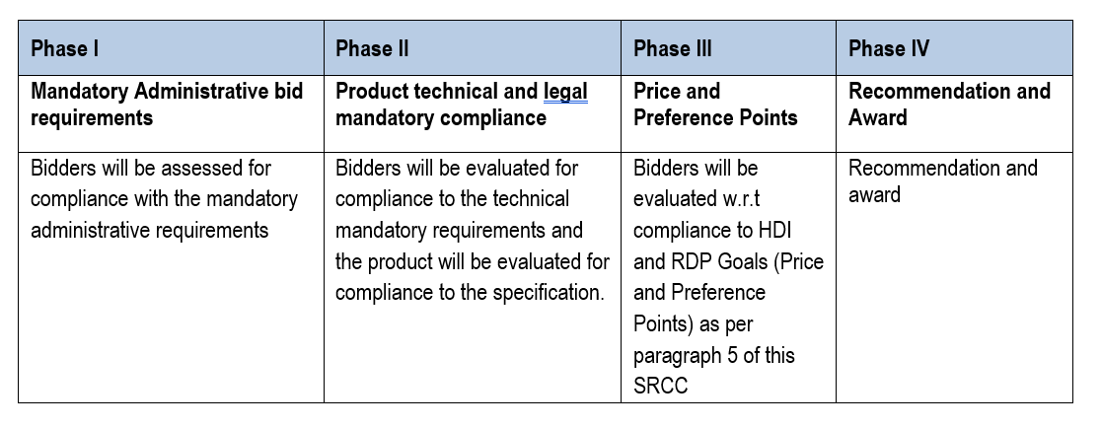
7
Evaluation Criteria
Phases of evaluation

Slide 8
8
Administrative requirements (Phase I evaluation)
Registration on the Central Supplier Database (CSD)
Submission of Tax Clearance pin
    Bidders should be Tax compliant at time of the evaluation.
    All companies within a joint venture should be Tax compliant at time of the evaluation.
All bid documents listed in the Bid Document Checklist (Annex A), must be included in the bid and presented in the exact sequence as per checklist. (marked with tabs)
Notes:
Bidders are required to be registered on the CSD managed by National Treasury. The National Department of Health shall verify the bidder’s tax compliance status through the CSD.
Bidders are required to submit a Tax Clearance pin, issued by the South African Revenue Services (SARS).

Slide 9
9
Legislative requirements (Phase II evaluation)
The bidder offering a product must be the holder of a licence to manufacture medicines issued in terms of section 22C (1)(b) of the Medicines and Related Substances Act, 1965 (Act 101 of 1965), as amended.
The bidder offering a product must be the holder of a licence to manufacture, or import, distribute medical devices issued in terms of section 22C (1)(b) of the Medicines and Related Substances Act, 1965 (Act 101 of 1965), as amended.
A certified copy of the original license must be submitted by the bidder offering the product.
In case of a joint venture all companies in the agreement must supply their licence to manufacture medicines issued in terms of section 22C (1)(b) of the Medicines and Related Substances Act, 1965 (Act 101 of 1965), as amended.

Slide 10
10
Legislative requirements (Phase II evaluation) cont…
Items offered must be registered in terms of section 15 of the Medicines and Related Substances Act, (Act 101 of 1965), and must comply with the conditions of registration for the duration of the contract.
  A Certified copy of the Medicine Registration Certificate, must be included with the bid for all items offered.
  The bidder must be indicated as the applicant on the Medicine Registration Certificate
  Annexure A (Conditions of Registration) will only be required for newly registered medicines.
  Inclusive of any valid variation summaries approved by SAPHRA for amendments on the Medicine Registration Certificate.
  Note: (Both MRC and relevant variation summary must be submitted)

Slide 11
11
Sample submission and product technical compliance (Phase II evaluation)
All bidders are required to submit samples including bidders who are currently supplying the NDoH with products to confirm the following:
Compliance with specifications as set out in the bid document/ item specification.
Compliance of the product with the requirements of the Medicines and Related Substances Act, (Act 101 of 1965)
Samples must be submitted to both Health Facilities as indicated in the SRCC, before bid closure.
Samples received after Bid Closure will not be evaluated.
No samples must be sent to the National Department of Health.

Slide 12
12
Offering a bid price (Phase III evaluation)
Price breakdown
    The delivered price must be divided across five components:
  Active Pharmaceutical Ingredients (API);
  Formulation;
  Packaging;
  Logistics (this includes transportation, warehousing and distribution); and
  Gross margin (remaining portion).
    The sum of these categories must be equal to 100% of the delivered price for the line item.
    Bid Prices may not exceed SEP Ex Man + VAT and Full SEP
    Note: If no price breakdown is supplied in the Bid Response document, items will be deemed ineligible for CPA.

Slide 13
13
Contractual Price Adjustment (CPA)
    Only the portion of the bid price facing foreign exchange risk will be adjusted.
    Adjustments are always calculated using the original awarded contracted price as the base.
      the percentage change between a base average rate of exchange (RoE) and an adjustment average RoE.
    Rates are sourced from the Reserve Bank (www.resbank.co.za).
    Where no application for an adjustment relating to foreign exchange has been received and such an adjustment would be favourable to the Department, this will be implemented automatically.
    Foreign exchange adjustments may never result in a price exceeding the current Single Exit Price, ex Logistics.
    Further details regarding CPA’s, please refer to paragraph 23.2 to 23.6 of the SRCC.

Slide 14
14
Offering a bid price (Phase III evaluation) cont…
Price breakdown
All sections of the below example inclusive of currency must be completed.

Slide 15
15
NEW REGULATIONS PREFERENCE POINTS SYSTEM
Preference Points allocated according to the New 2022 Preferential Procurement Regulations - effective 16 January 2023.
HDI / RDP (10) AND
Same as in previous Regulations
Preference Points to be allocated according to 80/20 or 90/10 system.
New in 2022 Regulations:
10 or 20 Points no longer predetermined and related to B-BBEE Level
Institutions must indicate and allocate points for specific goals
Points relate to HDI & RDP Goals

Slide 16
16
PREFERENCE POINTS HDI
Points allocated for “specific goals” (as referenced in 2022 Preferential Procurement Regulations) may include:
HDI
“contracting with persons, or categories of persons, historically disadvantaged by unfair discrimination on the basis of race, gender and disability “
HDI Points (4 /10)
NDoH will allocate a percentage (%) of the 4 available points – equal to the equity ownership substantiated by supporting evidence

Slide 17
17
PREFERENCE POINTS - GENDER & DISABILITY
“contracting with persons, or categories of persons, historically disadvantaged by unfair discrimination on the basis of race, gender and disability “
Awarding of points for Gender (Female 2/10)
NDoH will allocate a percentage (%) of the 2 available points – equal to female equity ownership substantiated by supporting evidence
Awarding of points for Disability (2/10)
Same calculation as for Gender above, for equity ownership held by person with a disability.

Slide 18
18
PREFERENCE POINTS - RDP
RDP
“including the implementation of programmes of the Reconstruction and Development Programme (RDP) as published in Government Gazette No. 16085 dated 23 November 1994”
NDoH RDP Goal
The promotion of South African owned enterprises.
Allocation of preference points aligned with % ownership held by South African citizens within the bidding enterprise (ownership must be substantiated by supporting evidence)

Slide 19
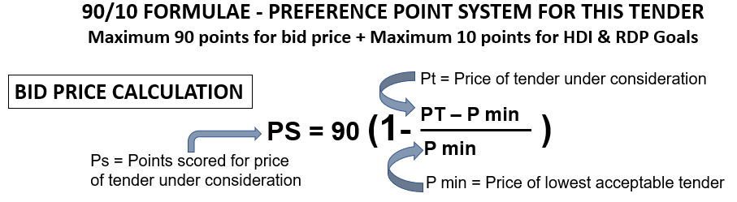
BID PRICE CALCULATION = 90% (90 points)

Slide 20
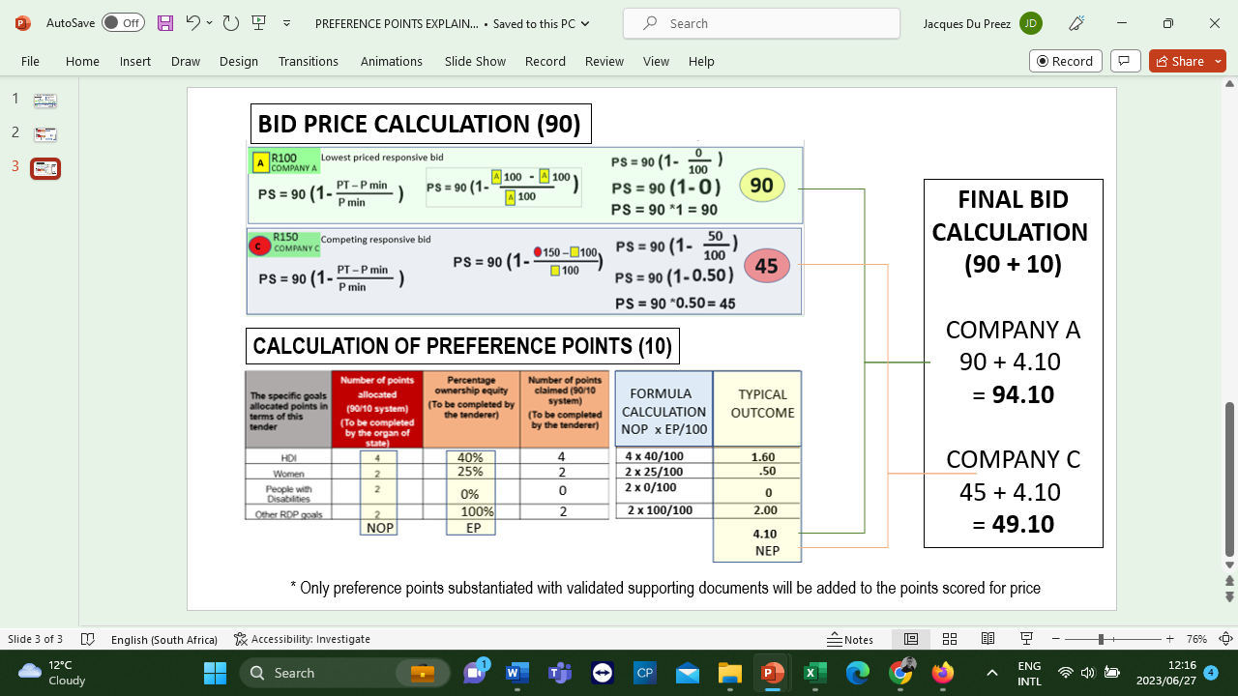
BID PRICE (90) CALCULATED

Slide 21
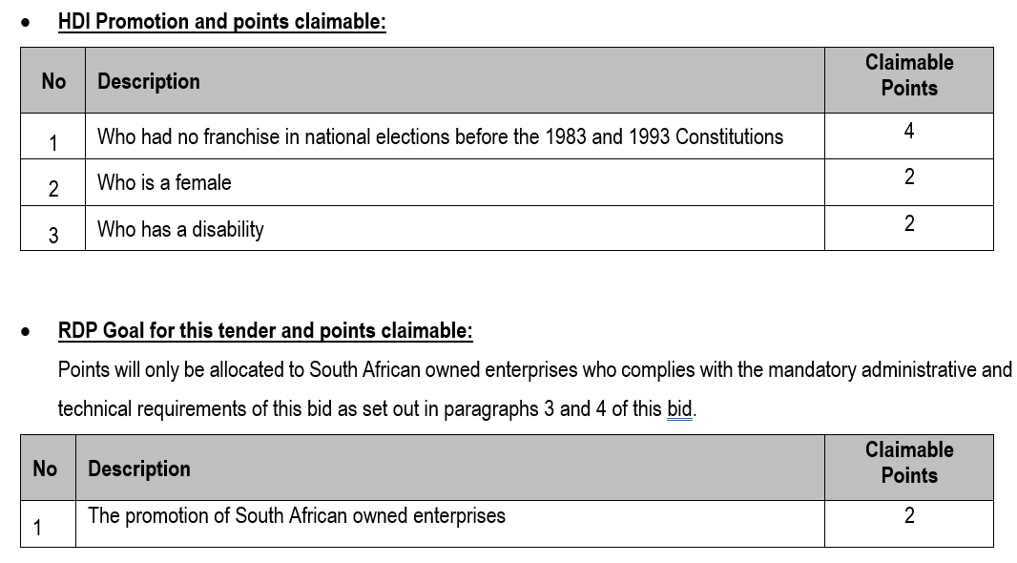
HDI AND RDP GOAL POINTS (SBD 6.1)

Slide 22
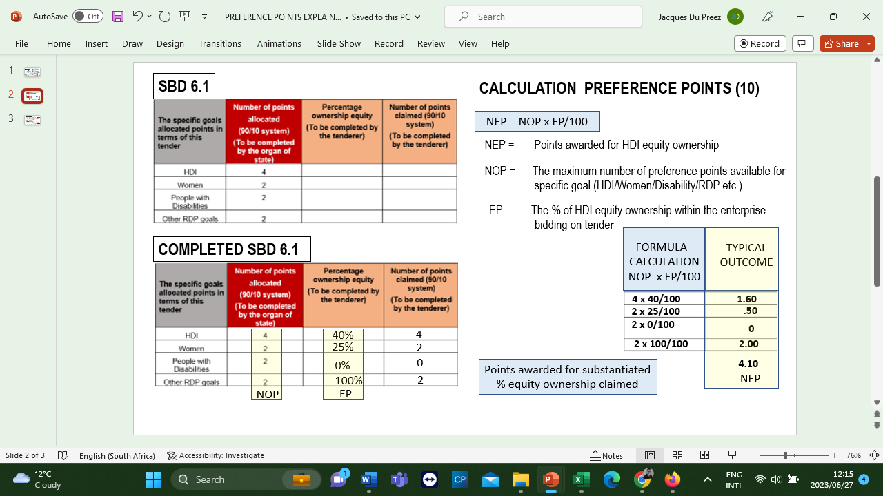
HDI + RDP POINTS CALCULATION
1.60
0.50
0
2.00

Slide 23
HDI + RDP 10 POINTS CALCULATION
(% EQUITY OWNERSHIP x POINTS AVAILABLE) = POINTS SCORED
1.60
0.50
0
2.00
POINTS
AVAILABLE
%
OWNERSHIP
CALCULATED
POINTS

Slide 24
BID PRICE (90) + HDI / RDP (10) CALCULATED
1.60
0.50
0
2.00

Slide 25
OTHER OWNERSHIP CLAIMS (SBD 6.1)
TRUSTS & OWNERSHIP SCHEMES
Equity claims for a Trust may only allowed for persons who are:
both Trustees and Beneficiaries
who are actively involved in the management of the Trust.
A Consortium / Joint Venture may, based on the % of the contract value managed or executed by their HDI members, be entitled to equity ownership in respect of HDI.
Substantiating evidence need to be presented with bid.

Slide 26
26
Award conditions
  The National Department of Health reserves the right to:
  negotiate prices.
  award the same item as a multiple award to various contractors (two or more) to address high volume requirements, security of supply and product availability.
  award to an item with a specification deviation.
  negotiate minimum order quantities where they are deemed unfavourable.
In cases where the tender does not achieve the most economically advantageous price, the National Department of Health reserves the right not to award that item.

Slide 27
27
Award conditions
  The following are examples of considerations which may be considered when contemplating a multiple award:
Source of Active Pharmaceutical Ingredient (API) and actual manufacturing site;
Capacity to meet expected demand as per published estimates in the Excel Bid Response Document;
Estimated volume to be supplied;
Risk to public health if the item is not available;
Past compliance of the bidder with contractual obligations.

Slide 28
28
Lead times and Quantities
    Quantities advertised = estimated volumes, not guaranteed.
    Fluctuations in monthly demand may occur.
    Proposed minimum order quantities should facilitate delivery directly to facilities.
    Initial lead time
    This period may not exceed 75 calendar days from the date of award.
    NOT from the date of publication of the contract circular.
    Lead time (within the contract period)
    This lead-time may not exceed 14 calendar days

Slide 29
29
Orders
    Only orders made on an official, authorised purchase order are valid.
    Suppliers are required to acknowledge receipt of all purchase orders received from participating authorities, in a manner stipulated by the relevant participating authority.
    Changes to any quantities ordered may only be made upon receipt of an amended purchase order.
    The Participating Authorities reserve the right to cancel orders where the lead time exceeds the delivery lead time specified in the contract.
    In cases where an order is received which appears to be irrational or misaligned with estimates, the contracted supplier must liaise with the relevant Participating Authority prior to processing the order.

Slide 30
30
Supplier Performance Management
    The National Department of Health, in collaboration with the Participating Authorities, will monitor the performance of contracted suppliers in terms of this contract, including but not limited to the following:
Compliance with delivery lead times;
Compliance with delivery in full as per the purchase order;
Percentage of orders delivered on time and in full;
Compliance with reporting requirements according to reporting schedule and reporting mechanism; and
Attendance of compulsory quarterly meetings
    Contracted Suppliers may be required to present continuous improvement initiatives aimed at improving efficiencies in the supply chain to benefit both suppliers and the Department

Slide 31
31
Supplier Performance Management
    Reporting requirements
As a minimum, suppliers will be required to submit the following:
All transactional data relating to orders;
A monthly age analysis;
Production pipeline data and forecast including:
  Number of units of the item available (stock on hand);
  Number of units of the item in Quality Assurance, awaiting release;
  Number of units of the item in the current month’s production plan.
Status of outstanding orders.

Slide 32
32
Continuity of supply
Suppliers are required to maintain sufficient buffer stock to meet at least two months demand for all items, aligned with the needs of participating Authorities.
Allowances for a reduced yet appropriate buffer stock will be made for the last two (2) months of the contract as agreed upon between NDoH and the contracted supplier.
Contractors must inform the National Department of Health at first knowledge of any circumstances that may result in interrupted supply, including but not limited to:
regulatory action which may impact on their GMP status or that of entities on which they are reliant;
any anticipated problems associated with the availability of active pharmaceutical ingredient (API);
industrial action;
challenges with manufacturing pipeline;
any other supply challenges.

Slide 33
33
Continuity of supply
  Contracted Suppliers must direct official communication relating to continuity of supply to stockalert@health.gov.za, as well as Participating Authorities;
  All official communication must include detail of corrective actions taken by the contracted supplier to ensure continuity of supply.
  It is the responsibility of the contracted supplier to ensure continuous availability and supply of contracted items. In the event that the contracted supplier is unable to supply, the contracted supplier will source alternative product of acceptable quality and up to the same quantity as required in terms of the contract. The substitute item will be supplied at the current price of the contracted item.

Slide 34
34
Shelf life
Unless MCC or SAHPRA, has approved a shorter shelf life, products must have a shelf-life of at least 12 months upon delivery.
  Contracted suppliers may apply in writing to PAs to supply a product with a shorter shelf life provided that:
  Applications are accompanied by an undertaking that such short-dated products will be unconditionally replaced or credited before or after expiry; and
  applications are approved before execution of orders; and
  upon notification of remaining expired stock such products will be collected by the supplier at their own cost; and
  failure to collect the products within 30 days after written notification to the supplier will result in the disposal of the product by the PA for the account of the supplier.
    Any PA may, without prejudice, decline to accept product with a shelf-life of less than 12 months.

Slide 35
35
Tips for Completing the Bid Document
  Bid Response Document
  Adobe Reader 9 or later must be used.
  This is available as a free download.
  If you have difficulty in downloading / opening or saving documents, first try opening the document online then saving from there to your computer. Add your company name to filename
  Only start completing in the document when downloaded and saved. Highlight existing fields to avoid missing any
  Fields can be corrected by overtyping – note that some fields could be “prefilled” from a previous entry
  Complete all fields, print and save, confirm correct, then complete any remaining empty fields, then sign and scan.
  Ensure that all fields in the final electronic copy correspond with the final printed copy (as latter is the legal bid)

Slide 36
36
Tips for Completing the Bid Document
  Excel Document
  Use Ms Excel® 2007 or later
  Complete ALL response fields in Excel for items on which bids are submitted
    Note carefully what unit is asked for: the estimates are expressed in these units
    Submit price according to this unit
    Certain fields are restricted to numbers only to avoid you entering spaces, commas or letters
    Do NOT make any changes to item numbers, item specifications or estimates or add / duplicate columns
    If you want to make additional offer on the same product, submit another Bid Response Document for that item – clearly naming it Alt_offer(s)

Slide 37
37
Final checks
  Finalising bid document
Double-check :
Accuracy and completeness of the completed document.
All bid prices are for the correct unit and are VAT-inclusive.
Print out the BRD
Compare the printed BRD with the electronic version (Ensure that all items are printed - printed version is the legal copy)
Sign every page of hard copy
Save and submit electronic completed BRD in Excel on a (USB) as Set 3 – and also save and submit a PDF copy of the signed BRD on a (USB) in Set 2.

Slide 38
38
CHALLENGES
  Found in previous tenders:
CD/USB either corrupt or no data saved (Ensure to check that the data is available and accessible);
Certification of relevant documents was found to be copies and not dated (Ensure it is an original stamp from a Commissioner of Oath and dated);
Compulsory bid documents not signed, if signed a copy was submitted (Ensure compulsory documents are signed in black wet ink in spaces provided)
Bidders do not initial each page in black wet ink (Ensure to check the full bid documents prior to submission that all relevant initials and signatures required are present)
Submission of 3 Party Authorisation letters as indicated on the Medicine Registration Certificate is compulsory (Please submit the relevant Authorisation as per the MRC)
Submission of the MRC Variation Summary approved by SAPHRA amending changes on the MRC (MRC must be submitted to verify amendment)
Legible electronic copy of the Package insert as part of Set 2 is a requirement
Naming convention of the electronic files is not in accordance with Annexure A Checklist.
Incorrect MRC Certificate supplied in bid pack.
Licence to Manufacture omitted from bid pack.
Samples only submitted to one facility instead of both, and also empty containers received (Artwork)

Slide 39



39
The centralised toll-free corruption hotline - 0800 701 701
Read more: http://www.southafrica.info/services/government/hotline-anticorruption.htm#.Vekno0YbJzA#ixzz3kkAPmrmo

Slide 40
40
Thank You
  Thank you for attending this Online Briefing Session
  The End
  Question can be emailed to tenders@health.gov.za

