Slide 1
1
Briefing session
HP01-2025TB, HP02-2025AI & HP13-2025ARV
Contracting, governance and policy unit
Ms. Marione Schonfeldt
26 July 2024

Slide 2
2
Contract dates
Closing date: 9 September 2024
Contract Period:
HP01-2025TB – 01 October 2025 to 30 September 2026 (2-year period)
HP02-2025AI – 01 October 2025 to 30 September 2027 (3-year period)
HP13-2025ARV – 01 July 2025 to 30 June 2027 (3-year period)
(Erratum 1 published 23 July 2025 relating to HP13-2025ARV)
HP tenders' advertisement platforms
  Available on NDoH website
  www.health.gov.za
  |Tenders| View Pharmaceutical Tenders
  Available on National Treasury Website
  www.treasury.gov.za
  e-tenders

Slide 3
3
Tender Documents
  Four documents must be downloaded per tender and saved:
    Bid pack
    2) Bid Response Document (in Excel)
    3) Annexure A – Checklist (in Excel)
    PBD9 Directors Categorisation Profile (in Excel and must be completed)
    Note: Its compulsory to submit certified copies of Director’s/Owners identification documents

Slide 4
4
Submission of bid documents
Submit 3 sets of your bid
    Set 1: Hard copy of Bid
    (constitutes as the legal binding bid document)
    Consisting of:
    Bid Pack, completed
    Annexure A Checklist, completed
    PBD9 Directors Categorisation Profile, completed
    Final Bid Response, completed
    Supporting documents as required in Bid Pack
      All pages must be initialled by signatory using ink.
      All relevant documents must be certified inclusive of certification date.
      Bind your bid include tabs showing each section (same as bid file index)
Notes:
All SBD, PBD and Bid Response forms fully completed and printed, signed where indicated.
Remaining entry fields completed clearly in black ink, handwritten in capital letters.

Slide 5
5
Submission of bid documents
Document Submission
    Set 2: Scanned mirror image of Set 1 (Hard Copy)
    Saved on USB consisting off:
    A folder for each section on Checklist (Annexure A)
    Each section containing scanned signed documents
    NB: Excel Bid Response (price),PBD9
Set 2 and Set 3 must be included on a single Universal Serial Bus (USB) Flash Drive / Storage Device and submitted in a sealed package with Set 1.
The full name and address of the bidder, including the return address of the bidder, the bid number and the closing date of the bid must be clearly indicated on the package.

Slide 6
6
Submission of bid documents
Document Submission
    Set 3: Electronic version of bid (Excel Documents)
    Completed Bid Response Document in Excel (not PDF)
    PBD9 Directors Categorisation Profile
    Annexure A Checklist
Set 2 and Set 3 must be included on a single Universal Serial Bus (USB) Flash Drive / Storage Device and submitted in a sealed package with Set 1.
The full name and address of the bidder, including the return address of the bidder, the bid number and the closing date of the bid must be clearly indicated on the package.

Slide 7
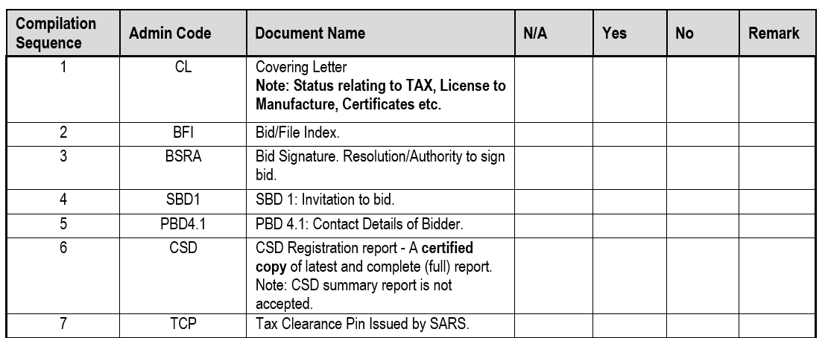
7
Submission of bid documents
All bid documents must be bound in a single file, with Tabs same as Index.
Index: All fields must be completed.
Where information requested is not relevant this should be indicated as N/A.

Slide 8
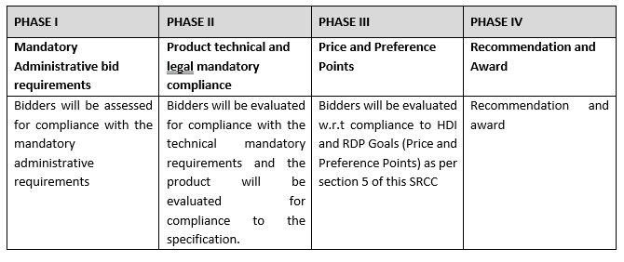
8
Evaluation Criteria
Phases of evaluation

Slide 9
9
Administrative requirements (Phase I evaluation)
Registration on the Central Supplier Database (CSD)
Tax Compliance Status
Bidders must be Tax compliant throughout bid validity period.
Submit a tax clearance pin.
Bid Submission – Hardcopy
All documents must be signed.
Sequence in bid file as per checklist (Annexure A).
Separated by section tabs.
Ensure USB included in bid file (containing Set2 & Set3)
Notes:
Bidders are required to be registered on the CSD managed by National Treasury. The National Department of Health shall verify the bidder’s tax compliance status through the CSD.
Bidders are required to submit a Tax Clearance pin, issued by the South African Revenue Services (SARS).

Slide 10
Legislative requirements (Phase II evaluation)
Licence Requirements:
If the product is deemed as a medicine by SAPHRA:
Bidder must be the holder of a licence to manufacture medicines issued in terms of section 22C (1)(b) of the Medicines Act, as amended.
Additionally, the bidder offering a product manufactured locally, must submit a copy of the license to manufacture medicines as issued by SAPHRA to the local manufacturer. (If local manufacturer is not the bidder, and is indicated on the MRC)
If the product is deemed a medical device by SAPHRA :
Bidder must be the holder of a licence to manufacture, or import, distribute medical devices issued in terms of section 22C (1)(b) of the Medicines Act, as amended.

Slide 11
Legislative requirements (Phase II evaluation)
Licence Requirements continue:
If the product is deemed as a complementary medicine by SAPHRA:
Bidder must be the holder of a licence to manufacture, import or export complementary medicines (Category D) issued in terms of section 22C(1)(b) Medicines Act, as amended
Or a Category A (Licence to manufacture) licence indicating complementary medicines.
Include the DA02 Product list issued by SAPHRA.
A certified copy of the applicable original license must be submitted by the bidder offering the product.
In case of a joint venture all companies in the agreement must supply their licence to manufacture medicines issued in terms of section 22C (1)(b) Medicines Act, as amended.

Slide 12
12
Legislative requirements
(Phase II evaluation) continue
Medicines offered must be registered in terms of section 15 of the Medicines Act and must comply with the conditions of registration for the duration of the contract.
The bidder must be indicated as the applicant on the Medicine Registration Certificate.
A Certified copy of the Medicine Registration Certificate, must be included for all items offered.
Inclusive of any valid variation summary approved by SAPHRA for amendments on the Medicine Registration Certificate.
Both MRC and relevant variation summary must be submitted.
Annexure A (Conditions of Registration) will only be required for newly registered medicines.
If the bidder is not the applicant, refer to section 5.2.1 of the SRCC for Consortium or Joint Venture agreements.

Slide 13
Legislative requirements (Phase II evaluation) continue: Joint Venture/Consortium (5.2.1)
A Consortium or a Joint Venture agreement is required for multiple enterprises combined in a bid.
The Consortium or Joint Venture agreement must be authenticated by a Commissioner of Oaths or other authorised official.
Non-compliance with authentication requirement will render the bid non-responsive.
All parties in the Consortium or Joint Venture must submit the legislative and mandatory requirements pertaining to this bid as indicated in the SRCC.
Refer to section 5.2.1 of the SRCC for further details pertaining to Joint Venture/Consortium
Examples for when a Consortium/Joint Venture agreement is required:

Slide 14
LEGISLATIVE REQUIREMENTS (PHASE II EVALUATION) JOINT VENTURE / CONSORTIUMS
Company A (Parent company)
Enterprise B (Bidder)
Joint Venture between
Enterprise B and Enterprise C
Enterprise C (Applicant)
Tender – Bid
  The bidder is not the applicant on the MRC, but the bidder and the applicant are subsidiaries of a single legal entity (same parent company)

Slide 15
LEGISLATIVE REQUIREMENTS (PHASE II EVALUATION)
JOINT VENTURE / CONSORTIUMS continued
Enterprise A
(Fully or Partly Own Enterprise B) – (Bidder)
Enterprise B (Applicant)
Joint Venture between
Enterprise A and Enterprise B
Tender – Bid
  The bidder is not the applicant on the MRC, but either the bidder or the applicant is fully or partially owned by the other.

Slide 16
LEGISLATIVE REQUIREMENTS (PHASE II EVALUATION)
JOINT VENTURE / CONSORTIUMS continued
Enterprise A
(Bidder)
Enterprise B (Applicant)
  The bidder is not the applicant on the MRC, but the bidder and the applicant are part of a technology transfer arrangement.
Technology transfer agreement
– In Progress
Joint Venture between
Enterprise A and Enterprise B
Tender – Bid

Slide 17
Authorisation Declaration
(Phase II evaluation)
Only the holder of a MRC issued in terms of the Medicines Act, may submit a bid.
If the manufacturer, or other entity, as listed on the MRC, are external third parties:
The bidder must ensure that all legal, financial and supply arrangements have been mutually agreed upon between the bidder and these third parties.
Must submit a signed Authorisation Declaration (PBD1.2) for each such third party.
Third Party information will be verified.
Note: Authorisation Declaration can only be submitted by the approved third party as indicated on the registration certificate.

Slide 18
Preference for Locally Produced Products (Phase II evaluation)
To provide preference to locally produced products, the definition of a locally produced product will be limited to product formulation and conversion processes that use materials and components to manufacture medicines in the Republic of South Africa.
Included: Fill and finish of sterile products (including vaccines)
Excluded: Fill, finish, and packaging of products such as solids, liquids, sterile drops and semi-solid dosage forms.
Requirement:
The local site is listed as a Manufacturer on the MRC issued by SAHPRA.
The Licence to Manufacture and all applicable annexures for the site are submitted.

Slide 19
19
Sample submission and product technical compliance (Phase II evaluation)
All bidders are required to submit samples including bidders who are currently supplying the NDoH with products to confirm the following:
Compliance with specifications as set out in the bid document/ item specification.
Compliance of the product with the requirements of the Medicines Act.
Samples must be submitted to both Health Facilities as indicated in the SRCC, before bid closure.
Samples received after Bid Closure will not be evaluated.
No samples must be sent to the National Department of Health.

Slide 20
20
Offering a bid price
(Phase III evaluation)
Price breakdown
    The delivered price must be divided across five components:
    Active Pharmaceutical Ingredients (API);
    Formulation;
    Packaging;
    Logistics (this includes transportation, warehousing and distribution); and
    Gross margin (remaining portion).
    The sum of these categories must be equal to 100% of the delivered price for the line item.
    Bid Prices may not exceed SEP Ex Man + VAT and Full SEP
    Note: If no price breakdown is supplied in the Bid Response document, items will be deemed ineligible for CPA.

Slide 21
21
Contractual Price Adjustment (CPA) - Section 23 of the SRCC
    Only the portion of the bid price facing foreign exchange risk will be adjusted.
    Adjustments calculated using the original awarded contracted price as the base.
    The percentage change between a base average rate of exchange (RoE) and an adjustment average RoE.
    Rates are sourced from the Reserve Bank (www.resbank.co.za).
    Where no application for an adjustment relating to foreign exchange has been received and such an adjustment would be favourable to the Department, this will be implemented automatically.
    Foreign exchange adjustments may never result in a price exceeding the current Single Exit Price, ex Logistics.
    Additional CPA at the start of the contract has been implemented please refer to the CPA Exceptional section 23.1.5 of the SRCC for further detail.
    Note: A foreign currency must be declared on the Bid Response document to be eligible for CPA.

Slide 22
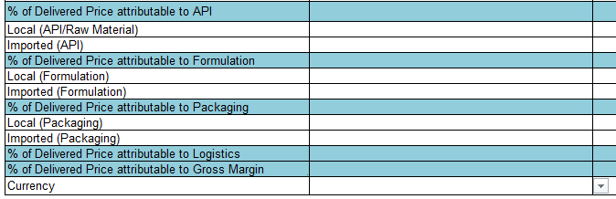
22
Offering a bid price
(Phase III evaluation) continue
Price breakdown
All sections of the below example inclusive of currency must be completed.
Note: Please select the relevant currency by clicking on the dropdown arrow.

Slide 23
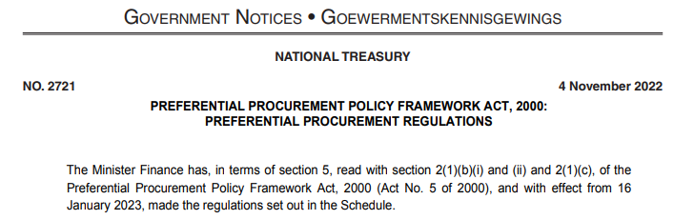
2022 Preferential Procurement Regulations - 16 January 2023
Placeholder for Public Procurement Bill

Slide 24
Public Procurement Bill : Status update
PUBLIC ROCUREMENT BILL
Signed by President
24 July 2024
Act 28 of 2024
The Bill proposes a single centralised procurement system for the state that will regulate public procurement and prescribe a framework within which preferential procurement must be implemented.

Slide 25
Act 28 of 2024 -Transitional Provisions
Continuity for In-Progress Tenders:
Tenders that were published before the signing of the new Act by the President will continue to be governed by the Procurement Regulations of 2022.
This ensures that there is no disruption or confusion for tenders already in progress.
The existing rules, including the use of SBD6.1 for allocating preferential points, will apply until these tenders are concluded.

Slide 26
2022 Preferential Procurement Regulations
Interpretation
Background: 2022 Regulations compared with 2017 Regulations:
10 Points (90/10) no longer predetermined and related to B-BBEE Level
Institutions must indicate and allocate points for HDI & RDP (SBD6.1)
HDI x 8 points / RDP Goal x 2 Points
CALCULATION OF POINTS
% ownership supported by share certificates, translate into same % of points available (i.e. RDP 50% ownership = 50% of 2 points = 1 Point)
% ownership x % of Points available = Points Allocated

Slide 27
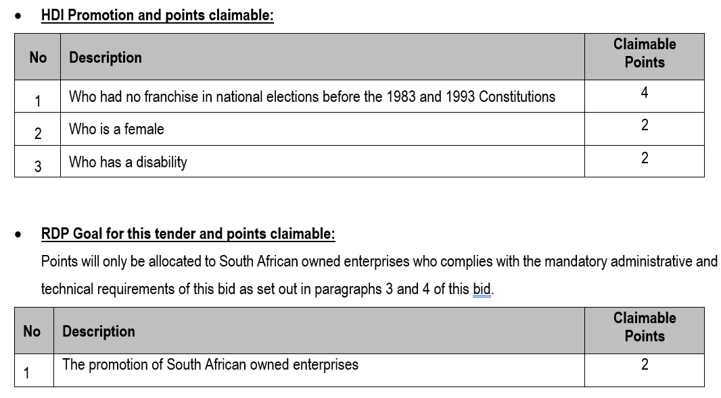
HDI and RDP Goal Points (SBD 6.1)

Slide 28
28
Preference Points Defined - HDI
Points allocated for “specific goals” (as referenced in 2022 Preferential Procurement Regulations) may include:
HDI
“contracting with persons, or categories of persons, historically disadvantaged by unfair discrimination on the basis of race, gender and disability “
HDI Points (4 /10)
NDoH will allocate a percentage (%) of the 4 available points aligned with the equity ownership.
Ownership must be substantiated by share certificate/s.

Slide 29
29
Preference Points - Gender & Disability
“contracting with persons, or categories of persons, historically disadvantaged by unfair discrimination on the basis of race, gender and disability “
Awarding of points for Gender (Female 2/10)
NDoH will allocate a percentage (%) of the 2 available points for female equity ownership substantiated by evidence.
Ownership must be substantiated by share certificate/s.
Awarding of points for Disability (2/10)
Same calculation as for Gender above, for equity ownership held by person/s with a disability.
Ownership must be substantiated by share certificate/s.

Slide 30
30
Preference Points - RDP
RDP
“including the implementation of programmes of the Reconstruction and Development Programme (RDP) as published in Government Gazette No. 16085 dated 23 November 1994”
RDP Goal: The promotion of South African owned enterprises.
Allocation of preference points aligned with % ownership held by South African citizens within the bidding enterprise.
Ownership must be substantiated with share certificate/s

Slide 31
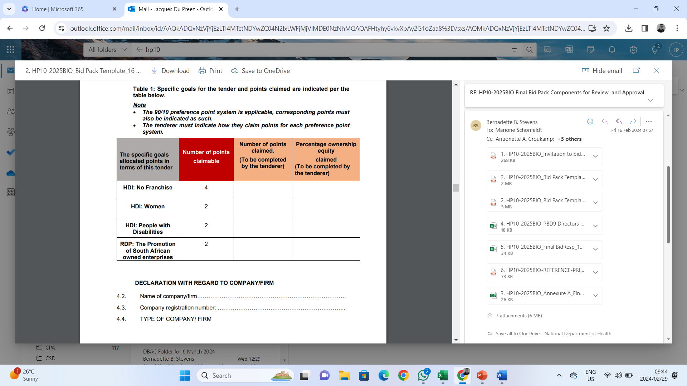
SBD 6.1 HDI + RDP Claim Document

Slide 32
SBD 6.1 HDI + RDP Claim Document
SET
POINTS
AVAILABLE
SUBSTANTIATED
HDI / RDP
OWNERSHIP
IN BIDDING ENTERPRISE

Slide 33
SBD 6.1 HDI + RDP Claim Document
40%
25%
0%
100%
SET
POINTS
AVAILABLE
SUBSTANTIATED
HDI / RDP
OWNERSHIP IN
BIDDING ENTERPRISE

Slide 34
SBD 6.1 HDI + RDP Claim Document
1.60
0.50
0
2.00
40%
25%
0%
100%
SET
POINTS
AVAILABLE
BIDDER POINTS
CLAIMED
AFTER OWN
CALCULATION
SUBSTANTIATED
HDI / RDP
OWNERSHIP IN
BIDDING ENTERPRISE

Slide 35
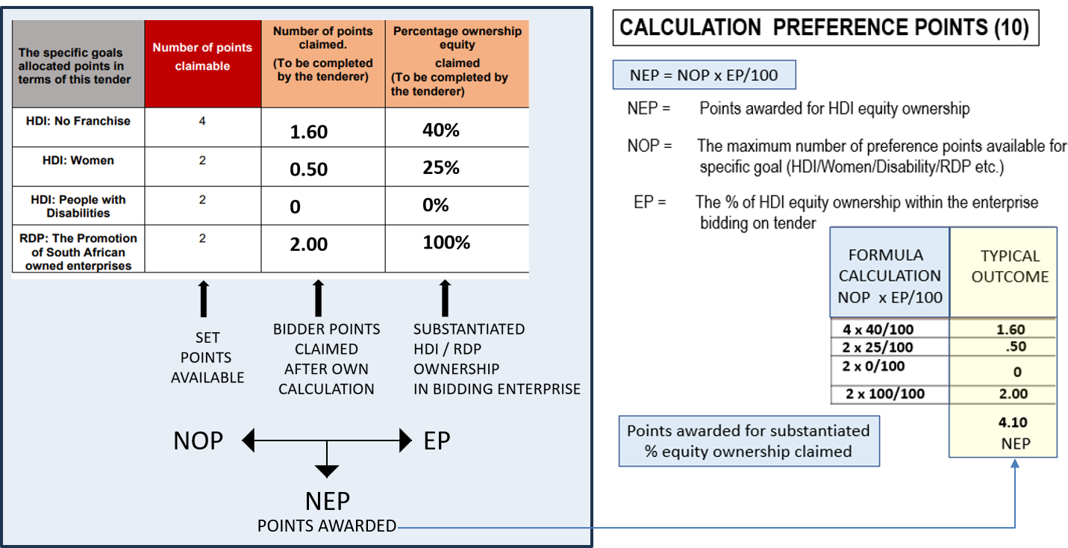
SBD 6.1 HDI + RDP Points Calculation
(Maximum 10 Points)
% EQUITY OWNERSHIP x POINTS AVAILABLE = POINTS SCORED

Slide 36
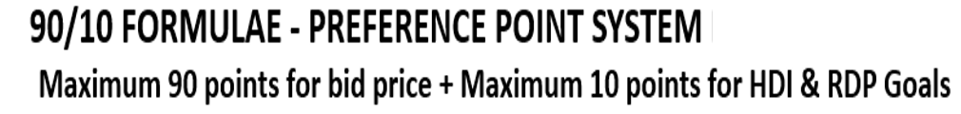

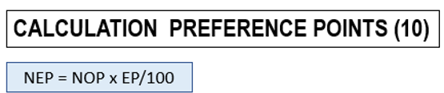
90/10
Points & Ranking of Bids Received
TOTAL POINTS SCORED & DETERMINES RANKING OF BID
Notes:
Compliance to all specifications and regulations – all other bids prices measured against lowest and calculated accordingly, to obtain a score out of 90

Slide 37
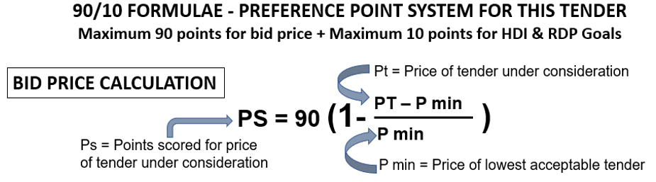
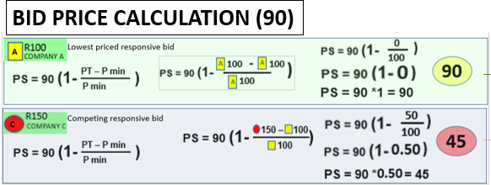
Bid Price (90 Points) Calculation
Bidding Enterprise A vs Bidding Enterprise C
Lowest priced, responsive bid, becomes the benchmark

Slide 38
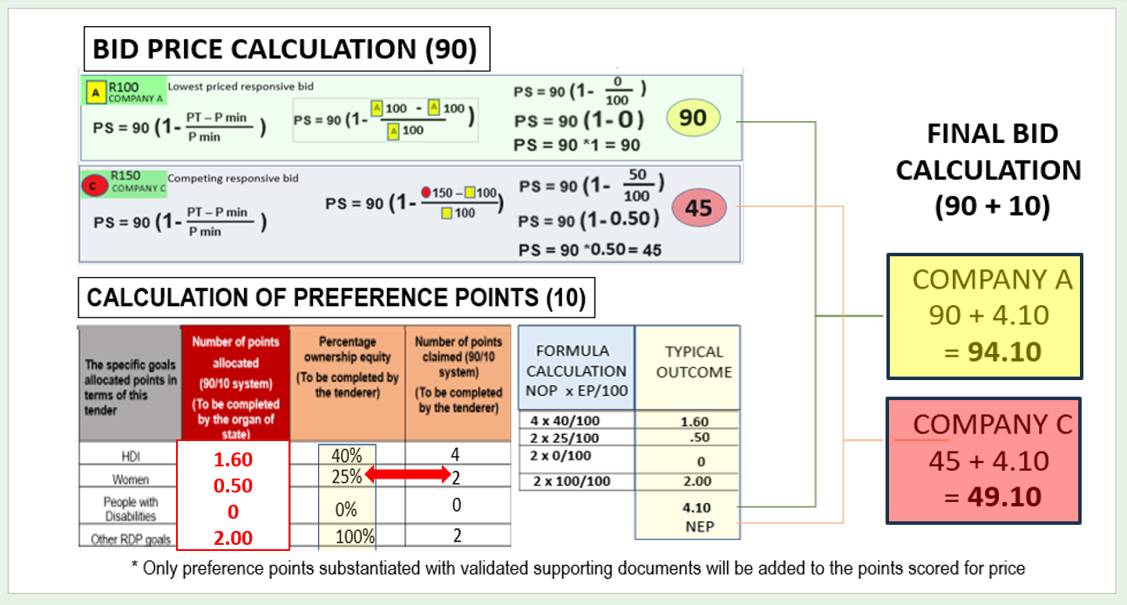
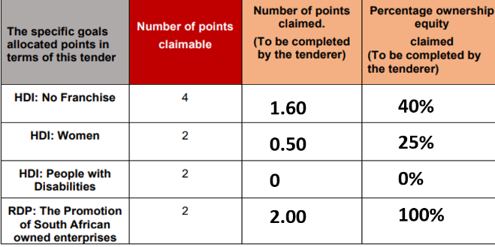
Bid Ranking
PRICE POINTS COMBINED WITH PREFERENCE POINTS = BID RANKING POINTS
PRICE
POINTS
POINTS
PREF

Slide 39
Other Ownership Claims (SBD 6.1)
TRUSTS & OWNERSHIP SCHEMES
Equity claims for a Trust may only allowed for persons who are:
both Trustees and Beneficiaries
who are actively involved in the management of the Trust.
A Consortium / Joint Venture may, based on the % of the contract value managed or executed by their HDI members, be entitled to equity ownership in respect of HDI.
Substantiating evidence need to be presented with bid.

Slide 40
40
Award conditions
  The National Department of Health reserves the right to:
  negotiate prices
  award the same item as a multiple award to various contractors (two or more) to address high volume requirements, security of supply and product availability
  award to an item with a specification deviation
  negotiate minimum order quantities where they are deemed unfavourable.
In cases where the tender does not achieve the most economically advantageous price, the National Department of Health reserves the right not to award that item.

Slide 41

41
Award conditions - HP13-2025ARV
Global Fund donations are applicable in this tender
A percentage of the estimated volumes of the products listed below may be reserved for procurement in accordance with the Global Fund donation.
To be eligible for this procurement, the awarded products must be listed on the WHO prequalified list.
Reference Price
Published for items on HP13-2025ARV

Slide 42
42
Award conditions – HP02-2025AI & HP13-2025ARV
Therapeutic Classes (SRCC – section 21.2)
Therapeutic class is defined as a group of medicines which have active ingredients with comparable therapeutic effects. Medicines in a therapeutic class may or may not belong to the same pharmacological class, may differ in chemistry or pharmacokinetic properties, and may possess different mechanisms of action, result in different adverse reaction, have different toxicity, and drug internation profiles.
In most cases, these medicines have close similarity in efficacy and safety profiles, when administered in equipotent doses for a specific indication.

Slide 43
43
Award conditions – HP02-2025AI & HP13-2025ARV
Source documents
https://knowledgehub.health.gov.za/e-library
Primary Healthcare (PHC) Therapeutic Interchange Database 2020-3_21 September2021
Adult Hospital Level Therapeutic Interchange Database_30June2020
# HP02-2025AI & HP13-2025ARV
A single member of the class may be awarded.

Slide 44
44
Request for information
HP13-2025ARV
Request for Information: Cabotegravir Long-Acting Injection
Published 15 July 2024 and closing 9 September 2024
HP13-RFI01 of 2024
Description:
Cabotegravir Long Acting (CAB-LA) 200mg/ml injection,3ml
Indication:
For the prevention of HIV infection in HIV negative individuals at risk
of HIV Acquisition.

Slide 45
45
Award conditions
  The following are examples of considerations which may be considered when contemplating a multiple award:
Source of Active Pharmaceutical Ingredient (API) and actual manufacturing site;
Capacity to meet expected demand as per published estimates in the Excel Bid Response Document;
Estimated volume to be supplied;
Risk to public health if the item is not available;
Past compliance of the bidder with contractual obligations.

Slide 46
46
Lead times and Quantities
    Initial lead time
    This period may not exceed 75 calendar days from the date of award.
    NOT from the date of publication of the contract circular or 1st order received.
    Lead time
    (within the contract period)
    This lead time may not exceed 14
    calender days
    Quantities advertised = estimated volumes, not guaranteed.
    Fluctuations in monthly demand may occur.
    Proposed minimum order quantities should facilitate delivery directly to facilities.

Slide 47
47
Orders
    Only orders made on an official, authorised purchase order are valid.
    Suppliers are required to acknowledge receipt of all purchase orders received from participating authorities, in a manner stipulated by the relevant participating authority.
    Changes to any quantities ordered may only be made upon receipt of an amended purchase order.
    The Participating Authorities reserve the right to cancel orders where the lead time exceeds the delivery lead time specified in the contract.
    In cases where an order is received which appears to be irrational or misaligned with estimates, the contracted supplier must liaise with the relevant Participating Authority prior to processing the order.

Slide 48
48
Supplier Performance Management
    The National Department of Health, in collaboration with the Participating Authorities, will monitor the performance of contracted suppliers in terms of this contract, including but not limited to the following:
Compliance with delivery lead times;
Compliance with delivery in full as per the purchase order;
Percentage of orders delivered on time and in full;
Compliance with reporting requirements according to reporting schedule and reporting mechanism; and
Attendance of compulsory quarterly meetings
    Contracted Suppliers may be required to present continuous improvement initiatives aimed at improving efficiencies in the supply chain to benefit both suppliers and the Department

Slide 49
49
Supplier Performance Management
    Reporting requirements
As a minimum, suppliers will be required to submit the following:
All transactional data relating to orders;
A monthly age analysis;
Production pipeline data and forecast including:
  Number of units of the item available (stock on hand);
  Number of units of the item in Quality Assurance, awaiting release;
  Number of units of the item in the current month’s production plan.
Status of outstanding orders.

Slide 50
50
Continuity of supply
Suppliers are required to maintain sufficient buffer stock to meet at least two months demand for all items, aligned with the needs of participating Authorities.
Allowances for a reduced yet appropriate buffer stock will be made for the last two (2) months of the contract as agreed upon between NDoH and the contracted supplier.
Contractors must inform the National Department of Health at first knowledge of any circumstances that may result in interrupted supply, including but not limited to:
regulatory action which may impact on their GMP status or that of entities on which they are reliant;
any anticipated problems associated with the availability of active pharmaceutical ingredient (API);
industrial action;
challenges with manufacturing pipeline;
any other supply challenges.

Slide 51
51
Continuity of supply
  Contracted Suppliers must direct official communication relating to continuity of supply to stockalert@health.gov.za, as well as Participating Authorities;
  All official communication must include detail of corrective actions taken by the contracted supplier to ensure continuity of supply.
  It is the responsibility of the contracted supplier to ensure continuous availability and supply of contracted items.
  If the contracted supplier is unable to supply, the contracted supplier will source alternative product of acceptable quality and up to the same quantity as required in terms of the contract.
  The substitute item will be supplied at the current price of the contracted item.

Slide 52
Continuity of supply as per updated SRCC
Supplier Inability to Supply (Less than 6 Months):
If a contracted supplier in a split/multiple award cannot supply an item for up to six months, the NDoH can reallocate volumes to another contracted supplier temporarily.
Supplier Inability to Supply (More than 6 Months):
If a supplier cannot supply an item for more than six months, the NDoH can cancel the contract as per Section 23 of the GCC (Clause 21.2).
Penalties for Delays: Suppliers may face penalties for exceeding the contractual lead time as per Section 22 of the GCC.
Procurement Outside the Contract: Participating Authorities can purchase outside the contract if the contracted item is not available within the 14-day lead time. The cost difference between the contracted supplier's item and the alternative item will be borne by the contracted supplier.

Slide 53
53
Shelf life
Unless MCC or SAHPRA, has approved a shorter shelf life, products must have a shelf-life of at least 12 months upon delivery.
  Contracted suppliers may apply in writing to PAs to supply a product with a shorter shelf life provided that:
  Applications are accompanied by an undertaking that such short-dated products will be unconditionally replaced or credited before or after expiry; and
  applications are approved before execution of orders; and
  upon notification of remaining expired stock such products will be collected by the supplier at their own cost; and
  failure to collect the products within 30 days after written notification to the supplier will result in the disposal of the product by the PA for the account of the supplier.
    Any PA may, without prejudice, decline to accept product with a shelf-life of less than 12 months.

Slide 54
54
Tips for Completing the Bid Document
  Bid Response Document - Adobe Reader 9 or later must be used.
  This is available as a free download.
  If you have difficulty in downloading / opening or saving documents, first try opening the document online then saving from there to your computer. Add your company name to filename
  Only start completing the document when downloaded and saved. Highlight existing fields to avoid missing any
  If your Adobe does not allow to complete electronically, complete the document by hand, using black ink.
  Fields can be corrected by overtyping – note that some fields could be “prefilled” from a previous entry
  Complete all fields, print and save, confirm correct, then complete any remaining empty fields, then sign and scan.
  Ensure that all fields in the final electronic copy correspond with the final printed copy (as latter is the legal bid)

Slide 55
55
Tips for Completing the Bid Document
  Excel Document
  Use Ms Excel® 2007 or later
Complete ALL response fields in Excel for items on which bids are submitted
Note carefully what unit is asked for: the estimates are expressed in these units
Submit price according to this unit Certain fields are restricted to numbers only to avoid you entering spaces, commas or letters DO NOT make any changes to item numbers, item specifications or estimates or add / duplicate columns
If you want to make additional offer on the same product, submit another Bid Response Document for that item – clearly naming it Alt_offer(s)

Slide 56
56
Final checks
  Finalising bid document
Double-check :
Accuracy and completeness of the completed document.
All bid prices are for the correct unit and are VAT-inclusive.
Print out the BRD
Compare the printed BRD with the electronic version (Ensure that all items are printed - printed version is the legal copy)
Sign every page of hard copy
Save and submit electronic completed BRD in Excel on a USB as Set 3, and also;
Save and submit a PDF copy of the signed BRD on the USB as Set 2.

Slide 57
57
  Challenges found in previous tenders:
CD/USB either corrupt or no data saved (Ensure to check that the data is available and accessible);
Certification of relevant documents was found to be copies and not dated (Ensure it is an original stamp from a Commissioner of Oath and dated);
Compulsory bid documents not signed, if signed a copy was submitted (Ensure compulsory documents are signed in black wet ink in spaces provided)
Bidders do not initial each page in black wet ink (Ensure to check the full bid documents prior to submission that all relevant initials and signatures required are present)
Submission of 3 Party Authorisation letters as indicated on the Medicine Registration Certificate is compulsory (Please submit the relevant Authorisation. If it deviates from the MRC kindly provide a detailed explanation for the reasons thereof)
Submission of the MRC Variation Summary approved by SAPHRA amending changes on the MRC (MRC must be submitted to verify amendment)
Legible electronic copy of the Package insert as part of Set 2 is a requirement
Naming convention of the electronic files is not in accordance with Annexure A Checklist.
Incorrect MRC Certificate supplied in bid pack.
Licence to Manufacture omitted from bid pack.

Slide 58



58
The centralised toll-free corruption hotline - 0800 701 701
Read more: http://www.southafrica.info/services/government/hotline-anticorruption.htm#.Vekno0YbJzA#ixzz3kkAPmrmo

Slide 59
59
Thank You
  Thank you for attending this Online Briefing Session
  The End
  Question can be emailed to tenders@health.gov.za

