Slide 1
1
Briefing session
HP05-2027DI
Contracting, Governance and Policy Unit
19 June 2026

Slide 2
2
Contract dates
Closing date: 3 August 2026
Contract Period:
HP05-2027DI : 1 July 2027 to 30 June 2030
HP tenders' advertisement platforms
  Available on NDoH website
  www.health.gov.za
  |Tenders| View Pharmaceutical Tenders
  Available on National Treasury Website
  www.treasury.gov.za
  e-tenders

Slide 3
Tender Documents
  Seven documents must be downloaded per tender and saved:
Bid pack
Bid Response Document (Excel) – Price submission
Annexure A – Checklist (Excel)
Annexure B – Invoice requirements
PBD4.1 – Bidders’ Contact Details (Excel)
PBD9.1 – Directors Categorisation Profile Single Bid Entity (Excel)
PBD9.2 – Directors Categorisation Profile JV Consortium Partnership (Excel)
The above documents form part of the tender package and must be completed together with all supporting documents required in the SRCC

Slide 4
Presentation of Tender Documents
Bid submitted in a sealed package / envelope - clearly indicating:
full name and address of the bidder,
return address
the bid number
closing date
The single envelope / package consisting of 3 Sets
Set 1: Signed hard-copy legally binding bid.
  All hard-copy documents must be signed
  Sequence in bid file as per checklist (Annexure A)
  Separated by section tabs.
Set 2: PDF scan of the complete signed Set 1 (on USB)
Set 3: Original editable Excel files (on same USB)

Slide 5
Set 1: Hard Copy Submission
A. Completed & Signed
SBD1 – Invitation to bid
SBD4 – Bid declaration
SBD5 – NIPP participation
SBD6.1 – Preference points
PBD3 / PBD3.1 – Bid authorisation
PBD4.1 – Bidders contact details
PBD5 – GMP compliance
PBD8 – Declaration of compliance SRCC and GCC
PBD9.1 / PBD9.2 – Director categorisation
PBD11 – Financial disclosure
C. Supporting documents
CSD report
Tax PIN
CIPC documents
B-BBEE certificate/EME/QSE affidavit
Licence to Manufacture
MRCs
Variation summaries
Third-party authorisations
Package inserts
Multi-entity agreements
– if bidder is not the applicant
All other supporting documents required by the SRCC
B. Excel docs Printed & Signed
BRD (Price)
Annexure A
(Checklist)
PBD4.1
PBD9.1 or PBD9.2
D. SRCC & GCC
Special Requirements and Conditions of Contract and General Conditions of Contract
Initialled on every page

Slide 6
6
Bid Submission: PDF Set 2 & Set 3
    Set 2 should contain:
      PDF of the entire signed Set 1
      Same sequence as Annexure A
      Same signed documents
      Same supporting documents
    Set 2
    A scanned PDF copy
    of the signed hard-copy bid.
Set 3 is the original editable electronic files and is not a scan and includes the original Mandatory Excel files)
Bid Response Document (Price Schedule)
Annexure A Checklist
PBD4.1
PBD9.1 or PBD9.2 Directors Categorisation Profile
in original Excel format
Notes:
Bidders are required to be registered on the CSD managed by National Treasury. The National Department of Health shall verify the bidder’s tax compliance status through the CSD.
Bidders are required to submit a Tax Clearance pin, issued by the South African Revenue Services (SARS).

Slide 7
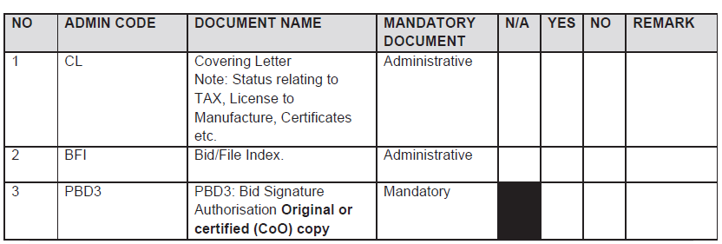
7
Indexed submission of bid documents
All bid documents must be bound in a single file (hard copy)
Use file Tabs & naming convention same as Index ADMIN CODE.
Submission of bid documents is required unless a specific document is not applicable, in which case the bidder must explicitly indicate "N/A" and provide a justification for its exclusion. If a section is blacked out in the "N/A" field, it is not considered a valid selection option for the bidder.
NB: All Index fields must be completed.
The absence of mandatory documents will impact the bid's responsiveness.

Slide 8
8
Submission of bid documents - (Index / Annexure A)
Annexure A is a guidance document intended to facilitate compliance and support ease of bid submission.
Each section must be read in conjunction with the relevant provisions of the SRCC, as well as the GCC.
The NDoH reserves the right to request any administrative document or information for clarification if it does not change the substance of the bid.
The bidder will have seven (7) working days to submit the requested document or information.
Scanned copies must be identical to the hard copy submissions. In the event of any discrepancy, the hard copy shall take precedence.

Slide 9
9
Phases of evaluation
PHASE I | PHASE II | PHASE III | PHASE IV
Administrative evaluation | Product technical evaluation: Legal and regulatory | Price and Preference Points evaluation | Recommendation and Award
Bidders will be assessed for compliance with the mandatory administrative requirements | Bidders will be evaluated for compliance with the technical mandatory requirements, and the product will be evaluated for compliance to the specification. | Bidders will be evaluated for Price and B-BBEE Status Level of Contributor in accordance with Section 9 of the SRCC | Recommendation and award

Slide 10
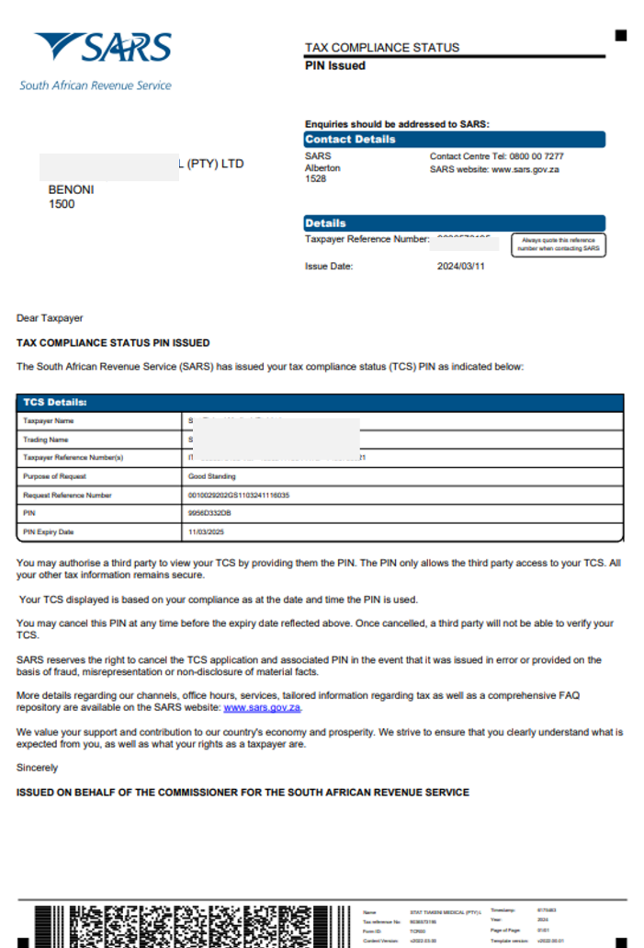
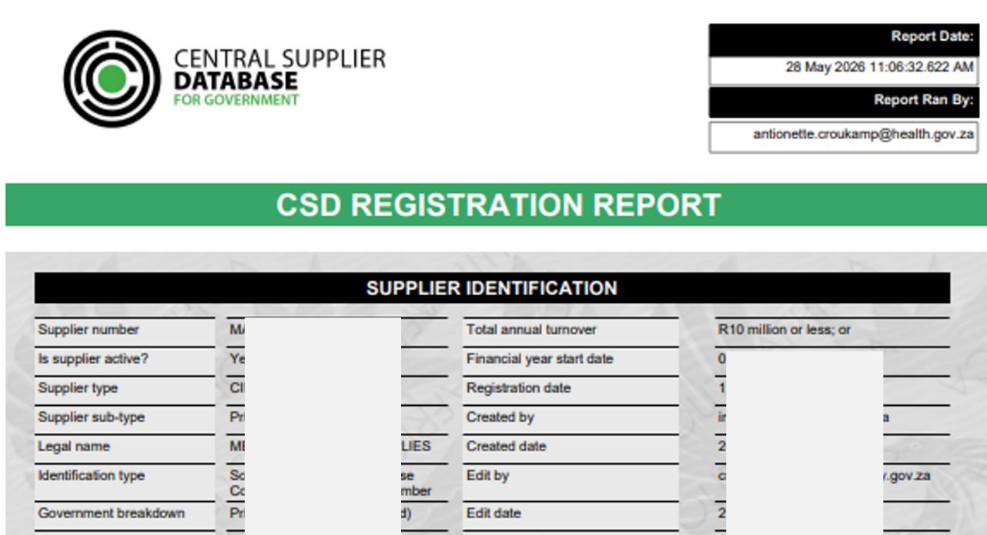
10
Administrative requirements - (Phase I evaluation)
Bidders are required to:
Submit bid documents as outlined in bid document
Checklist (Annexure A) aligned to SRCC
Include all mandatory documents specified
Be registered on the Central Supplier Database (CSD)
Submit a Tax Compliance Status PIN
Note:
Bidders must be Tax compliant throughout validity period.
EXAMPLE
Notes:
Bidders are required to be registered on the CSD managed by National Treasury. The National Department of Health shall verify the bidder’s tax compliance status through the CSD.
Bidders are required to submit a Tax Clearance pin, issued by the South African Revenue Services (SARS).

Slide 11
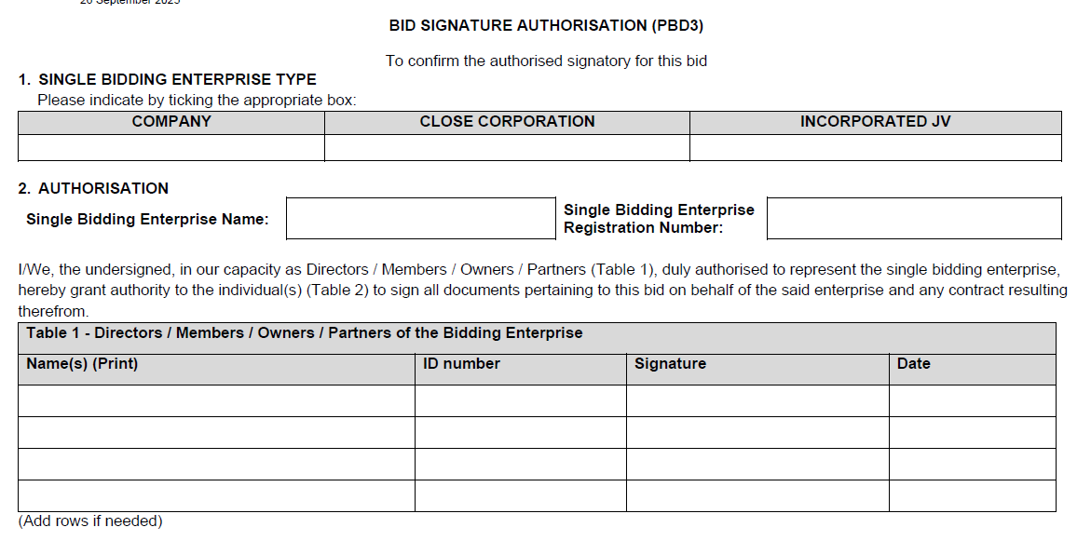
11
Administrative requirements (Phase I evaluation) PBD3 – SRCC Sec 7.2
PBD3 AND PBD3.1: BID SIGNATURE AUTHORISATION
Use the original template from the bid pack.
PBD3 is for single bidding enterprise
PBD3.1 required for multi-entity bidding enterprise
If a copy of this mandatory document is submitted, it must be certified by a Commissioner of Oaths as a true copy of the original.
Failure to comply will render the bid non-responsive.
Note: Separate
Board Resolution
not required
Notes:
Bidders are required to be registered on the CSD managed by National Treasury. The National Department of Health shall verify the bidder’s tax compliance status through the CSD.
Bidders are required to submit a Tax Clearance pin, issued by the South African Revenue Services (SARS).

Slide 12
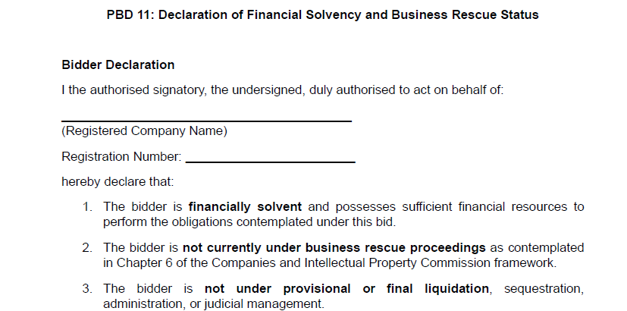
12
Administrative requirements (Phase I evaluation) PBD11 – SRCC Sec 7.6
PBD11 DECLARATION OF FINANCIAL SOLVENCY
AND BUSINESS RESCUE STATUS
All bidders must declare its financial solvency and declare if in business rescue.
Bidders that are under business rescue proceedings must disclose such status in their bid submission and provide a business rescue plan approved by the duly authorised business rescue practitioner, demonstrating the bidder’s continued operational and financial capacity to perform and fulfil the obligations of the contract.
Notes:
Bidders are required to be registered on the CSD managed by National Treasury. The National Department of Health shall verify the bidder’s tax compliance status through the CSD.
Bidders are required to submit a Tax Clearance pin, issued by the South African Revenue Services (SARS).

Slide 13
Administrative requirements : (Phase I evaluation)
JV / Consortium / Partnership - Agreements
If the bidder is not the applicant as required in section 8.2 (SRCC)
a signed agreement between the bidder and the applicant must be included in the bid submission.
This applies in the following cases:
The bidder is not the applicant on the MRC, but both the bidder and the applicant are subsidiaries of a single legal entity (same parent company).
The bidder is not the applicant on the MRC, but either the bidder or the applicant is fully or partially owned by the other.
The bidder is not the applicant on the MRC, but the bidder and the applicant are part of a technology transfer arrangement.

Slide 14
The bidder is not the applicant ….
(subsidiaries of same parent company)
Company A (Parent company)
Enterprise B (Bidder)
AGREEMENT between
Enterprise B and Enterprise C
Enterprise C (Applicant)
Tender – Bid
  The bidder is not the applicant on the MRC
  Bidder and the Applicant are subsidiaries of a single legal entity (same parent company)
signed agreement
required

Slide 15
The bidder is not the applicant ….
(ownership in one another)
Enterprise A (Bidder)
(Fully or Partly Own Enterprise B)
Enterprise B (Applicant)
AGREEMENT between
Enterprise A and Enterprise B
Tender – Bid
  The bidder is
    not the applicant on the MRC
    either the bidder or the applicant is fully or partially owned by the other
signed agreement
required

Slide 16
The bidder is not the applicant ….
(technology transfer)
Enterprise A
(Bidder)
Enterprise B (Applicant)
  The bidder is
  not the applicant on the MRC
  bidder and the applicant are part of a technology transfer arrangement
Technology transfer agreement
– In Progress
AGREEMENT between
Enterprise A and Enterprise B
Tender – Bid
signed agreement
required

Slide 17
Administrative requirements (Phase I evaluation)
JV / Consortium / Partnerships (SRCC 7.13)
Entities specified in the signed agreement between the bidder and the applicant must submit all mandatory documents including the following:
Bidder
Applicant
SBD 1: Invitation to Bid
CSD Report
SARS Tax Clearance Pin
CIPC Registration Certificate
SBD 4: Declaration of Interest
SBD 5: NIP
SBD 6.1 Preference Points Claim
Valid B-BBEE Certificate or EME/QSE Affidavit (where applicable)
PBD 8: SRCC/GCC Declaration of Compliance
9.1 / PBD 9.2 Directors Profile
PBD11: Declaration of financial solvency and business rescue status
CSD Report
SARS Tax Clearance Pin
CIPC Registration Certificate
SBD 6.1 Preference Points Claim
Valid B-BBEE Certificate or EME/QSE Affidavit (where applicable)
9.1 / PBD 9.2 Directors Profile
PBD3.1: Bid Signature Authorisation
single document (PBD 3.1) to be signed by all listed PBD9.1/PBD9.2 directors of all entities in bidding enterprise (Bidder and Applicant)

Slide 18
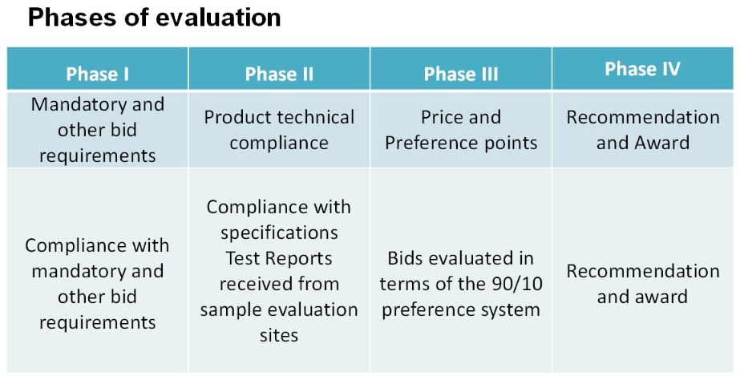
Phase II Evaluation
Evaluated as per the requirements stated in bid document & SRCC

Slide 19
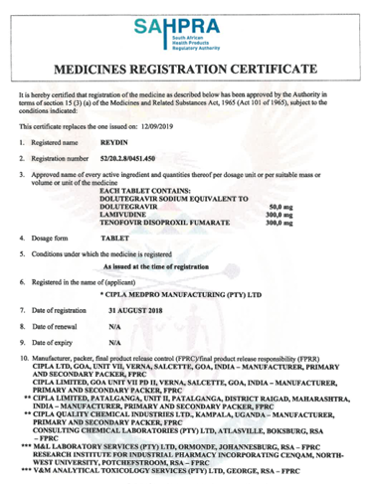
19
Legislative requirements (Phase II evaluation)
MRC - Single Bidding Enterprise
Medicines offered must be registered in terms of section 15 of the Medicines Act and must comply with the conditions of registration for the duration of the contract.
The bidder must be indicated as the applicant on the Medicine Registration Certificate.
A Certified copy of the Medicine Registration Certificate, must be included for all items offered.
Inclusive of any valid variation summary approved by SAHPRA for amendments on the Medicine Registration Certificate.

Slide 20
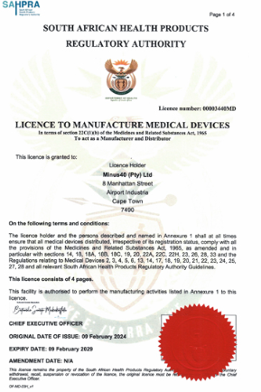
20
Legislative requirements (Phase II evaluation)
Licence to Manufacture
The bidder offering a product must be the holder of a licence to manufacture medicines and/or medical devices issued in terms of section 22C (1)(b) of the Medicines and Related Substances Act, 1965 (Act 101 of 1965), as amended.
A certified copy of the original license must be submitted by the bidder offering the product.
Specific licenses required for Class A, B, C or Class D medical devices or an in vitro diagnostic (IVD)
Specific licenses required to supply Category D- Complementary medicines
To receive preference for local manufacturing – a copy of the license to manufacture must be supplier for the local manufacturers – must also appear as manufacturing site on the MRC

Slide 21
Legislative requirements (Phase II evaluation)
Bidder not Applicant – JV / Consortium / Partnership
If the bidder is not the applicant as required (SRCC Sec 8.2), however,
is aligned with any of the relationship configurations described for multi bidding enterprises,
has a formal signed agreement between the bidder and the applicant presented in the bid submission,
Must also include mandatory legislative documents for all parties in the multi bidding enterprise, inclusive of :
  A valid license to manufacture (bidder and applicant), along with certified copies as per section 5.1, must be provided for all parties involved in the bid.
  An MRC where one of the parties in the multi entity bidding enterprise is identified as the applicant.
  Related documents indicated in the SRCC (Sec 7.13 / 8.2)

Slide 22
Authorisation Declaration - (Phase II evaluation)
The manufacturer, or other entity, as listed on the MRC, are considered external third parties:
If the holder of the Medicines Registration Certificate (MRC) is not the manufacturer of the product offered in this bid, a third-party manufacturer authorisation is required.
In such cases, the bidder must establish a formal legal agreement with the third-party manufacturer and submit a signed Authorisation Declaration (PBD1.2) from the relevant manufacturer as approved by SAHPRA which must be listed on the MRC.
Note: Authorisation Declaration can only be submitted by the approved third party as indicated on the registration certificate.

Slide 23
Preference for Locally Produced Products (Phase II evaluation)
To provide preference to locally produced products, the definition of a locally produced product will be limited to product formulation and conversion processes that use materials and components to manufacture medicines in the Republic of South Africa.
Included: Fill and finish of sterile products (including vaccines, large and small volume parenterals)
Excluded: Fill, finish, and packaging of products such as solids, liquids, sterile drops and semi-solid dosage forms.
Requirement:
The local site is listed as a Manufacturer on the MRC issued by SAHPRA.
The valid licence to Manufacture and all applicable annexures for the site are submitted.

Slide 24
Preference for Locally Produced Products (Phase II evaluation)
Requirement continue:
The formulation component of the price, as reflected in the Bid Response document described in Section 33.1 of this SRCC, represents the local manufacturing contribution associated with the processing, formulation, and production activities undertaken within South Africa..

Slide 25
25
Sample submission and product technical compliance (Phase II evaluation)
All bidders are required to submit samples including bidders who are currently supplying the NDoH with products, to confirm the following:
Product compliance with
  specifications as set out in the bid document/ item specification.
  the requirements of the Medicines Act.
Samples must be submitted to both Health Facilities as indicated in the SRCC, before bid closure.
Samples received after Bid Closure will not be evaluated.
No samples must be sent to the National Department of Health.

Slide 26
26
Compliance to specifications (Phase II evaluation)
All medicines must be supplied in:
  complete, patient-ready packaging in the specified pack size,
  using containers that are properly sealed and labelled in compliance with Medicines Act.
  Packaging must be in a ready-to-dispense format that does not require any manipulation, packing, or repacking by the dispensing healthcare workers.

Slide 27
27
Phase III - Offering a bid price
Price breakdown
    The delivered price must be divided across five components:
    Active Pharmaceutical Ingredients (API);
    Formulation;
    Packaging;
    Logistics (this includes transportation, warehousing and distribution); and
    Gross margin (remaining portion).
    The sum of these categories must be equal to 100% of the delivered price for the line item.
    Bid Prices may not exceed SEP Ex Man + VAT nor Full SEP
    Note: If no price breakdown or Foreign Currency is supplied in the Bid Response document, items will be deemed ineligible for CPA.

Slide 28
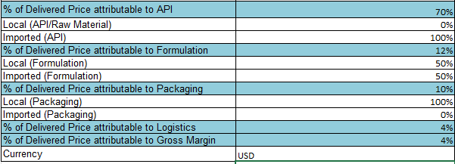
28
Phase III - Offering a bid price (continued)
Price breakdown
Example
Note: Please select the relevant currency by clicking on the dropdown arrow.

Slide 29
Phase III Evaluation
Evaluated as per the requirements stated in bid document & SRCC

Slide 30
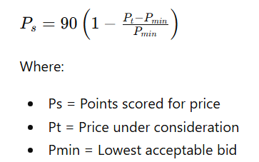
Phase III: Allocation of Price Points
A maximum of 90 points will be allocated for price.
Price points will be calculated using the formula prescribed by the Preferential Procurement Regulations, 2022.

Slide 31
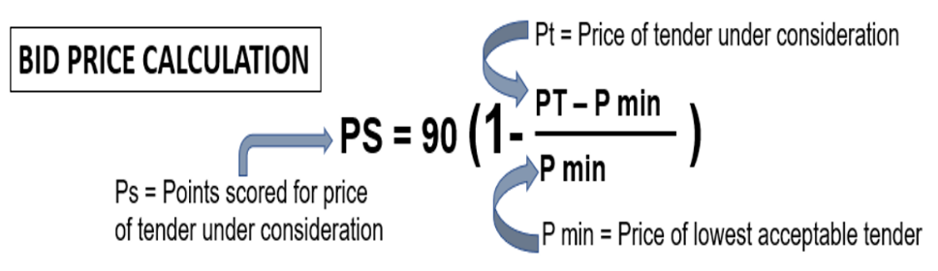
Points & Ranking of Bids Received - 90/10
Price (90 Points) + B-BBEE Status Level of Contributor (10 Points)
= Total Ranking Score
B-BBEE Status Level of Contributor (Max 10 Points)
TOTAL POINTS SCORED & DETERMINES RANKING OF BID
Notes:
Compliance to all specifications and regulations – all other bids prices measured against lowest and calculated accordingly, to obtain a score out of 90

Slide 32

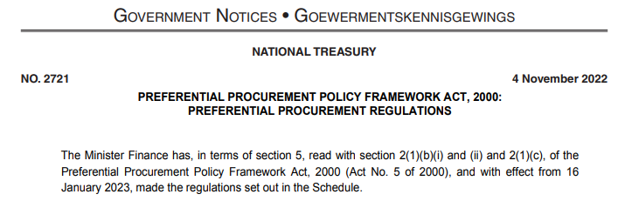
2022 Preferential Procurement Regulations
Placeholder for Public Procurement Bill / Public Procurement Act, 2024
Organs of State may select preference points allocations and select own specific goal/s within the framework of the Regulations.
A revised NDoH specific goal aligned with NDoH SCM Policy was introduced recently through a formal BEC process.
Specific goal applicable to this tender The promotion of companies with higher B-BBEE contribution levels (Status Levels 1-4), with preferential points allocated to B-BBEE (as reflected in Table 1 on SBD6.1 claim form)

Slide 33
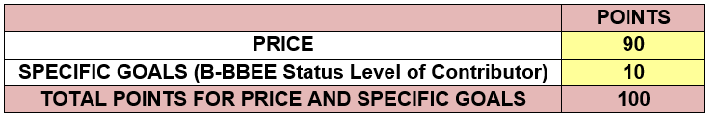
Price and Preference Points Allocation
Responsive bids will proceed to Phase III evaluation after successful completion of:
Phase I Administrative Evaluation
Phase II Product Technical Evaluation
Price and Preference Points Evaluation
The 90/10 preference point system will be applied.
Points allocated as follows:

Slide 34
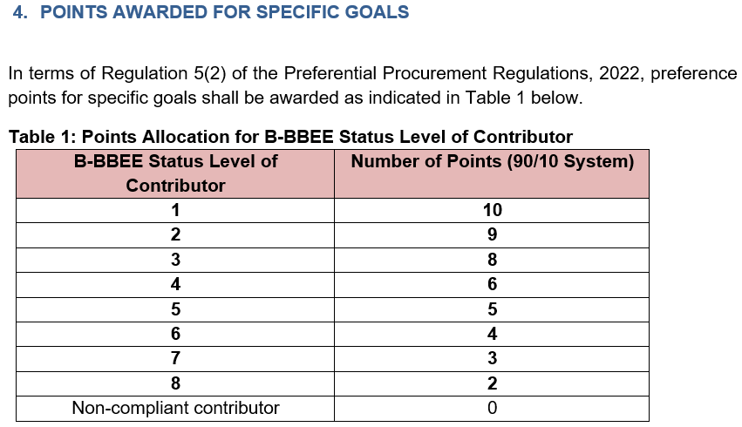
Allocation of Preference Points
Allocation of Preference points will be allocated according to the bidder’s
B-BBEE Status Level of Contributor.
Very Important:
To claim (SBD6.1) B-BBEE preference points, bidders must submit:
Valid SANAS accredited B-BBEE Certificate
or
Valid EME Affidavit
or
Valid QSE Affidavit
Requirements:
Supporting evidence must be valid on bid closing date
Be issued in the name of the bidding entity
Bidder must indicate level and points claimed, and sign SBD6.1

Slide 35
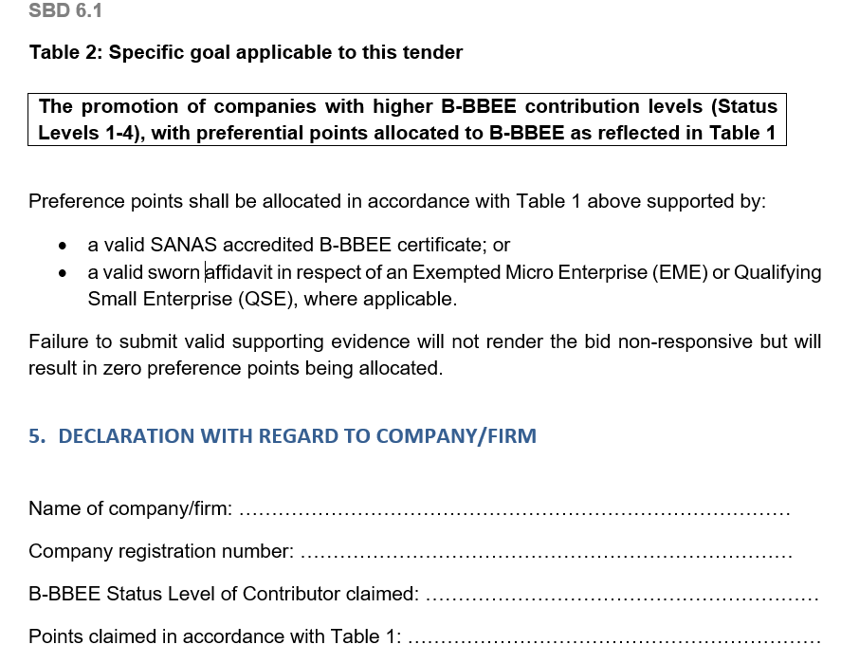
Completing the SBD6.1 claim form
POINTS CLAIMED
(See page 3 of 4 pages
Par 5 of SBD6.1 Form)

Slide 36
Failure to Submit Valid B-BBEE Documents
❌ Failure to submit valid proof:
Does NOT make the bid non-responsive
However:
✔ Bid proceeds to evaluation
! Bid receives 0 preference points

Slide 37
SBD6.1 claims in Multi-Entity Bids
Bids received from a multi-entity bidding enterprise where bidder is not the applicant, as per Section 7.13 and Section 9.4.
Preferential Points Claim Requirements:
Both bidder and applicant must submit:
B-BBEE Certificates or EME/QSE Affidavits
Preference points will be allocated:
Option 1
Based on agreed percentage contribution towards tender execution in the agreement
Option 2
If no percentage contribution is specified:
Lowest applicable B-BBEE score applies

Slide 38
Phase III: Bid Ranking
Total points determine ranking.
Highest total score = Highest ranked bidder
Evaluation Component | Maximum Points
Price | 90
B-BBEE | 10
Total | 100
Subject to:
  Responsiveness
  Technical compliance
  Objective criteria & award conditions (SRCC)

Slide 39
General Notes on claim submissions
Read the SRCC carefully
Be sure to complete each document very thoroughly
Submit appropriate supporting documents to substantiate any claim

Slide 40
Award conditions
  The National Department of Health reserves the right to:
  negotiate prices.
  award the same item as a multiple award to various contractors (two or more) to address high volume requirements, security of supply and product availability.
  award to an item with a specification deviation.
  negotiate minimum order quantities where they are deemed unfavourable.
In cases where the tender does not achieve the most economically advantageous price, the National Department of Health reserves the right not to award that item.

Slide 41

Award conditions
  The following are examples of considerations which may be considered when contemplating a multiple award:
Source of Active Pharmaceutical Ingredient (API) and actual manufacturing site;
Capacity to meet expected demand as per published estimates in the Excel Bid Response Document;
Estimated volume to be supplied;
Risk to public health if the item is not available;
Past compliance of the bidder with contractual obligations.

Slide 42
Contractual Price Adjustment Section 31 of the SRCC
    Envisaged price reviews:
  A routine adjustment to mitigate foreign exchange fluctuations;
  An exceptional adjustment to mitigate significant short-term foreign exchange fluctuations
ELIGIBILITY RELATING TO RATE OF EXCHANGE ADJUSTMENTS
Eligibility for price adjustments relating to foreign exchange risk depends on:
The submission of a complete price breakdown per instructions for all relevant products; a
Assessment of the rationality of this price breakdown by the National Department of Health

Slide 43
43
Contractual Price Adjustment (CPA) - continue
    Only the portion of the bid price facing foreign exchange risk will be adjusted.
    Adjustments calculated using the original awarded contracted price as the base.
    The percentage change between a base average rate of exchange (RoE) and an adjustment average RoE.
    Rates are sourced from the Reserve Bank (www.resbank.co.za).
    Where no application for an adjustment relating to foreign exchange has been received and such an adjustment would be favourable to the Department, this will be implemented automatically.
    Foreign exchange adjustments may never result in a price exceeding the current Single Exit Price.
    Additional CPA at the start of the contract has been implemented please refer to the CPA Exceptional section 34.1 of the SRCC for further detail.

Slide 44
44
Eligibility Price Breakdown
Price breakdown
In order to be eligible for Contractual Price Adjustments all sections of the below example inclusive of currency must be completed.
Note: Please select the relevant currency by clicking on the dropdown arrow.

Slide 45
Lead times and Quantities
    Quantities advertised = estimated volumes, not guaranteed.
    Fluctuations in monthly demand may occur.
    Proposed minimum order quantities should facilitate delivery directly to facilities.
    Initial lead time
    This period may not exceed 75 calendar days from the date of award.
    NOT from the date of publication of the contract circular.
    Lead time (within the contract period)
    This lead-time may not exceed 14 calendar days
    Minimum order quantities:
    Should facilitate deliveries to the lowest level of care

Slide 46
46
Orders
    Only orders made on an official, authorised purchase order are valid.
    Suppliers are required to acknowledge receipt of all purchase orders received from participating authorities, in a manner stipulated by the relevant participating authority.
    Changes to any quantities ordered may only be made upon receipt of an amended purchase order.
    The Participating Authorities reserve the right to cancel orders where the lead time exceeds the delivery lead time specified in the contract.
    In cases where an order is received which appears to be irrational or misaligned with estimates, the contracted supplier must liaise with the relevant Participating Authority prior to processing the order.

Slide 47
47
Supplier Performance Management
    The National Department of Health, in collaboration with the Participating Authorities, will monitor the performance of contracted suppliers in terms of this contract, including but not limited to the following:
Compliance with delivery lead times;
Compliance with delivery in full as per the purchase order;
Percentage of orders delivered on time and in full;
Compliance with reporting requirements according to reporting schedule and reporting mechanism; and
Attendance of compulsory quarterly meetings
    Contracted Suppliers may be required to present continuous improvement initiatives aimed at improving efficiencies in the supply chain to benefit both suppliers and the Department

Slide 48
48
Supplier Performance Management
    Reporting requirements
As a minimum, suppliers will be required to submit the following:
All transactional data relating to orders;
A monthly age analysis;
Production pipeline data and forecast including:
  Number of units of the item available (stock on hand);
  Number of units of the item in Quality Assurance, awaiting release;
  Number of units of the item in the current month’s production plan.
  Status of outstanding orders.

Slide 49
49
Continuity of supply
Suppliers are required to maintain sufficient buffer stock to meet at least two months demand for all items, aligned with the needs of participating Authorities.
Allowances for a reduced yet appropriate buffer stock will be made for the last two (2) months of the contract as agreed upon between NDoH and the contracted supplier.
Contractors must inform the National Department of Health at first knowledge of any circumstances that may result in interrupted supply, including but not limited to:
regulatory action which may impact on their GMP status or that of entities on which they are reliant;
any anticipated problems associated with the availability of active pharmaceutical ingredient (API);
industrial action;
challenges with manufacturing pipeline;
any other supply challenges.

Slide 50
50
Continuity of supply
  Contracted Suppliers must direct official communication relating to continuity of supply to stockalert@health.gov.za, as well as Participating Authorities;
  All official communication must include detail of corrective actions taken by the contracted supplier to ensure continuity of supply.
  It is the responsibility of the contracted supplier to ensure continuous availability and supply of contracted items.
  If the contracted supplier is unable to supply, the contracted supplier will source alternative product of acceptable quality and up to the same quantity as required in terms of the contract.
  The substitute item will be supplied at the current price of the contracted item.

Slide 51
Continuity of supply as per updated SRCC
Supplier Inability to Supply (Less than 6 Months):
If a contracted supplier in a split/multiple award cannot supply an item for up to six months, the NDoH can reallocate volumes to another contracted supplier temporarily.
Supplier Inability to Supply (More than 6 Months):
If a supplier cannot supply an item for more than six months, the NDoH can cancel the contract as per Section 23 of the GCC (Clause 21.2).
Penalties for Delays: Suppliers may face penalties for exceeding the contractual lead time as per Section 22 of the GCC.
Procurement Outside the Contract: Participating Authorities can purchase outside the contract if the contracted item is not available within the 14-day lead time. The cost difference between the contracted supplier's item and the alternative item will be borne by the contracted supplier.

Slide 52
52
Shelf life
Unless MCC or SAHPRA, has approved a shorter shelf life, products must have a shelf-life of at least 12 months upon delivery.
  Contracted suppliers may apply in writing to PAs to supply a product with a shorter shelf life provided that:
  Applications are accompanied by an undertaking that such short-dated products will be unconditionally replaced or credited before or after expiry; and
  applications are approved before execution of orders; and
  upon notification of remaining expired stock such products will be collected by the supplier at their own cost; and
  failure to collect the products within 30 days after written notification to the supplier will result in the disposal of the product by the PA for the account of the supplier.
    Any PA may, without prejudice, decline to accept product with a shelf-life of less than 12 months.

Slide 53
53
Tips for Completing the Bid Document
  Bid Response Document - Adobe Reader 9 or later must be used.
  This is available as a free download.
  If you have difficulty in downloading / opening or saving documents, first try opening the document online then saving from there to your computer.
  Add your company name to filename
  Only start completing the document when downloaded and saved. Highlight existing fields to avoid missing any fields
  If your Adobe does not allow to complete electronically, complete the document by hand, using black ink.
  Fields can be corrected by overtyping – note that some fields could be “prefilled” from a previous entry
  Complete all fields, print and save, confirm correct, then complete any remaining empty fields, then sign and scan.
  Ensure that all fields in the final electronic copy correspond with the final printed copy (as latter is the legal bid)

Slide 54
54
Tips for Completing the Bid Document
  Excel Document
  Use Ms Excel® 2007 or later
Complete ALL response fields in Excel for items on which bids are submitted
Note carefully what unit is asked for: the estimates are expressed in these units
Submit price according to this unit Certain fields are restricted to numbers only to avoid you entering spaces, commas or letters DO NOT make any changes to item numbers, item specifications or estimates or add / duplicate columns
If you want to make additional offer on the same product, submit another Bid Response Document for that item – clearly naming it Alt_offer(s)

Slide 55
55
Final checks
  Finalizing bid document
Double-check :
Accuracy and completeness of the completed document.
All bid prices are for the correct unit and are VAT-inclusive.
Print out the BRD
Compare the printed BRD with the electronic version (Ensure that all items are printed - printed version is the legal copy)
Sign every page of hard copy
Save and submit electronic completed BRD in Excel on a USB as Set 3, and also;
Save and submit a PDF copy of the signed BRD on the USB as Set 2.
Submission of complete set at NDoH bid box (Site indicated in SBD1)
Bidders are strongly advised to complete the Bid Box Register when submitting their bid.

Slide 56
56
Challenges found in previous tenders
USB either corrupt or no data saved - (ensure data is available and accessible);
Certification of relevant documents - found to be copies and not dated
Ensure compulsory documents are signed in black wet ink in spaces provided)
Bidders do not initial each page - check the full bid documents prior to submission
Submission of 3rd Party Authorisation letters as indicated on the Medicine Registration Certificate is compulsory (submit the relevant Authorisation and if it deviates from the MRC - provide detailed explanation for the reasons thereof

Slide 57
57
Challenges found in previous tenders (continued)
6. Submission of the MRC Variation Summary approved by SAHPRA - must be submitted to verify amendments
7. Legible electronic copy of the Package insert as part of Set 2 is a requirement
8. Naming convention of the electronic files not same as Annexure A Checklist.
9. Incorrect MRC Certificate in bid pack.
10. Licence to Manufacture omitted from bid pack.
11. Capacity calculation
12. Bid Response Document not accurately completed in full.

Slide 58



58
The centralised toll-free corruption hotline - 0800 701 701
Read more: http://www.southafrica.info/services/government/hotline-anticorruption.htm#.Vekno0YbJzA#ixzz3kkAPmrmo

Slide 59
59
Thank You
  Thank you for attending this Online Briefing Session
  The End
  Question can be emailed to tenders@health.gov.za

