Slide 1
1
Briefing session
HP06-2027SVP
Contracting, Governance and Policy Unit
5 June 2026

Slide 2
2
Contract dates
Closing date: 20 July 2026
Contract Period:
HP06-2027SVP : 1 May 2027 to 30 April 2030
HP tenders' advertisement platforms
  Available on NDoH website
  www.health.gov.za
  |Tenders| View Pharmaceutical Tenders
  Available on National Treasury Website
  www.treasury.gov.za
  e-tenders

Slide 3
Tender Documents
  Seven documents must be downloaded per tender and saved:
Bid pack
Bid Response Document (Excel) – Price submission
Annexure A – Checklist (Excel)
Annexure B – Invoice requirements
PBD4.1 – Bidders’ Contact Details (Excel)
PBD9.1 Directors Categorisation Profile_Single Bid Entity (Excel)
PBD9.2 Directors Categorisation Profile_JV_Consortium_Partnership (Excel)
The above documents form part of the tender package and must be completed together with all supporting documents required in the SRCC
Note: All Excel documents provided must be completed in Microsoft Excel and submitted on USB as Set 3 (in Excel format).
These Excel documents must be scanned, printed and signed as hard-copy Excel versions on USB as Set 2. In addition, Set 2 must also include a scanned copy of the complete signed bid submission (mirror of bid).
This entire compilation of forms (hard copies as Set 1) and is the legally binding bid.

Slide 4
Set1: Hard Copy Submission (legal bid document)
A. Completed & Signed
SBD1
SBD4
SBD5
SBD6.1
PBD3 / PBD3.1
PBD4.1
PBD5
PBD8
PBD9.1 / PBD9.2
PBD11
B. Excel docs Printed & Signed
BRD (Price)
Annexure A
(Checklist)
PBD4.1
PBD9.1 or PBD9.2
C. Supporting documents
CSD report
Tax PIN
CIPC documents
B-BBEE certificate/EME/QSE affidavit
Licences
MRCs
Variation summaries
Third-party authorisations
Package inserts
Multi-entity agreements
All other supporting documents required by the SRCC
D. SRCC & GCC
Initialled on every page

Slide 5
5
Set 2 – PDF mirror image of Set 1
    Therefore Set 2 should contain:
      PDF of the entire signed Set 1
      Same sequence as Annexure A
      Same signed documents
      Same supporting documents
    Set 2
    A scanned PDF copy
    of the signed hard-copy bid.

Slide 6
6
Set 3 – Electronic Source Files
Set 3 is not a scan and includes Mandatory Excel files
It contains the original editable electronic files.
Bid Response Document (Price Schedule)
Annexure A Checklist
PBD4.1
PBD9.1 or PBD9.2 Directors Categorisation Profile
in original Excel format
Set 2 and Set 3 must be included on a single Universal Serial Bus (USB) Flash Drive / Storage Device and submitted in a sealed package with Set 1.
The full name and address of the bidder, including the return address of the bidder, the bid number and the closing date of the bid must be clearly indicated on the package.

Slide 7
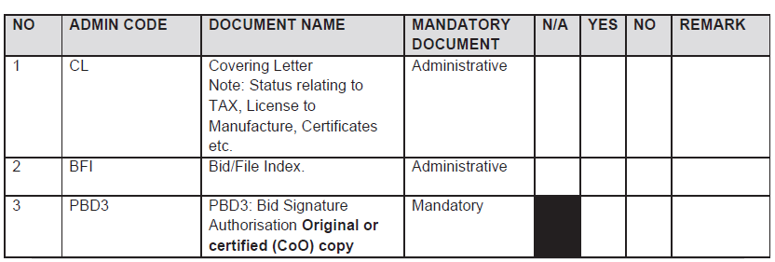
7
Submission of bid documents
All bid documents must be bound in a single file, with Tabs same as Index.
Index: All fields must be completed.
The absence of mandatory documents will impact the bid's responsiveness. Submission of bid documents is required unless a specific document is not applicable, in which case the bidder must explicitly indicate "N/A" and provide a justification for its exclusion. If a section is blacked out in the "N/A" field, it is not considered a valid selection option for the bidder.

Slide 8
8
Submission of bid documents
NOTE: Annexure A is a guidance document intended to facilitate compliance and support ease of bid submission. Each section must be read in conjunction with the relevant provisions of the SRCC, as well as the GCC.
The NDoH reserves the right to request any administrative document or information for clarification if it does not change the substance of the bid.
The bidder will have seven (7) working days to submit the requested document or information.
Scanned copies must be identical to the hard copy submissions. In the event of any discrepancy, the hard copy shall take precedence.

Slide 9
9
Phases of evaluation
Evaluation Criteria as per SRCC
PHASE I | PHASE II | PHASE III | PHASE IV
Administrative evaluation | Product technical evaluation: Legal and regulatory | Price and Preference Points evaluation | Recommendation and Award
Bidders will be assessed for compliance with the mandatory administrative requirements | Bidders will be evaluated for compliance with the technical mandatory requirements, and the product will be evaluated for compliance to the specification. | Bidders will be evaluated for Price and B-BBEE Status Level of Contributor in accordance with Section 9 of the SRCC | Recommendation and award

Slide 10
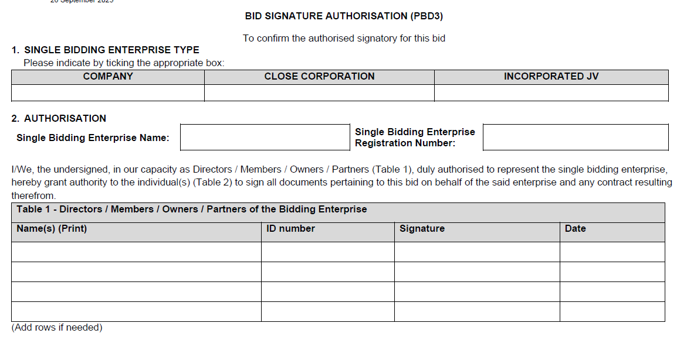
10
Administrative requirements (Phase I evaluation) Sec 7.2 of the SRCC
PBD3 AND PBD3.1: BID SIGNATURE AUTHORISATION
PBD3 is required for bids submitted by a single bidding entity.
PBD3.1 is required for bids submitted by a multi-entity bidding enterprise
The PBD3 or PBD3.1 must be the original template from the bid pack.
If a copy of this mandatory document is submitted, it must be certified by a Commissioner of Oaths as a true copy of the original.
Failure to comply will render the bid non-responsive.
Notes:
Bidders are required to be registered on the CSD managed by National Treasury. The National Department of Health shall verify the bidder’s tax compliance status through the CSD.
Bidders are required to submit a Tax Clearance pin, issued by the South African Revenue Services (SARS).

Slide 11
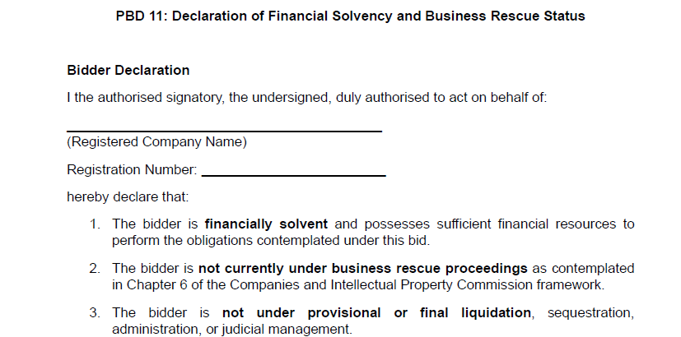
11
Administrative requirements (Phase I evaluation) Sec 7.6 of the SRCC
PBD11 DECLARATION OF FINANCIAL SOLVENCY
AND BUSINESS RESCUE STATUS
All bidders must declare its financial solvency and declare if in business rescue.
Bidders that are under business rescue proceedings must disclose such status in their bid submission and provide a business rescue plan approved by the duly authorised business rescue practitioner, demonstrating the bidder’s continued operational and financial capacity to perform and fulfil the obligations of the contract.
Notes:
Bidders are required to be registered on the CSD managed by National Treasury. The National Department of Health shall verify the bidder’s tax compliance status through the CSD.
Bidders are required to submit a Tax Clearance pin, issued by the South African Revenue Services (SARS).

Slide 12
12
Administrative requirements (Phase I evaluation) Sec 7 of the SRCC
Be registered on the NT Central Supplier Database (CSD)
Tax Compliance Status
Bidders must be Tax compliant throughout bid validity period.
Submit a tax clearance pin.
Bid Submission Hardcopy (Set 1)
All documents must be signed.
Sequence in bid file as per checklist (Annexure A).
Separated by section tabs.
Ensure USB included in bid file (containing Set2 & Set3)
Notes:
Bidders are required to be registered on the CSD managed by National Treasury. The National Department of Health shall verify the bidder’s tax compliance status through the CSD.
Bidders are required to submit a Tax Clearance pin, issued by the South African Revenue Services (SARS).

Slide 13
Administrative requirements : Joint Venture/Consortium/Partnerships (7.13)
In the case of a Consortium, Joint Venture (Incorporated or Unincorporated), and or Partnership an agreement is required
If the bidder is not the applicant as required in section 8.2
a signed agreement between the bidder and the applicant must be included in the bid submission.
This applies in the following cases:
The bidder is not the applicant on the MRC, but both the bidder and the applicant are subsidiaries of a single legal entity (same parent company).
The bidder is not the applicant on the MRC, but either the bidder or the applicant is fully or partially owned by the other.
The bidder is not the applicant on the MRC, but the bidder and the applicant are part of a technology transfer arrangement.

Slide 14
The bidder is not the applicant but….
Company A (Parent company)
Enterprise B (Bidder)
AGREEMENT between
Enterprise B and Enterprise C
Enterprise C (Applicant)
Tender – Bid
  The bidder is not the applicant on the MRC,
  but the bidder and the applicant are subsidiaries of a single legal entity (same parent company)

Slide 15
The bidder is not the applicant but….
Enterprise A
(Fully or Partly Own Enterprise B) – (Bidder)
Enterprise B (Applicant)
AGREEMENT between
Enterprise A and Enterprise B
Tender – Bid
  The bidder is not the applicant on the MRC,
  but either the bidder or the applicant is fully or partially owned by the other.

Slide 16
The bidder is not the applicant but….
Enterprise A
(Bidder)
Enterprise B (Applicant)
  The bidder is not the applicant on the MRC,
  but the bidder and the applicant are part of a technology transfer arrangement.
Technology transfer agreement
– In Progress
AGREEMENT between
Enterprise A and Enterprise B
Tender – Bid

Slide 17
Administrative requirements
Joint Venture/Consortium/Partnerships (7.13)
Entities specified in the signed agreement between the bidder and the applicant must submit all mandatory documents including the following:
Bidder
Applicant
SBD 1: Invitation to Bid
CSD Report
SARS Tax Clearance Pin
CIPC Registration Certificate
SBD 4: Declaration of Interest
SBD 5: NIP
SBD 6.1 Preference Points Claim
Valid B-BBEE Certificate or EME/QSE Affidavit (where applicable)
PBD 8: SRCC/GCC Declaration of Compliance
9.1 / PBD 9.2 Directors Profile
PBD11: Declaration of financial solvency and business rescue status
CSD Report
SARS Tax Clearance Pin
CIPC Registration Certificate
SBD 6.1 Preference Points Claim
Valid B-BBEE Certificate or EME/QSE Affidavit (where applicable)
9.1 / PBD 9.2 Directors Profile
PBD3.1: Bid Signature Authorisation
single document (PBD 3.1) to be signed by all listed PBD9.1/PBD9.2 directors of all entities in bidding enterprise (Bidder and Applicant)

Slide 18
Legislative requirements
(Phase II evaluation)
Licence Requirements:
If the product is deemed as a medicine by SAHPRA:
Bidder must be the holder of a licence to manufacture medicines issued in terms of section 22C (1)(b) of the Medicines Act, as amended.
Additionally, the bidder offering a product manufactured locally, must submit a copy of the licence to manufacture medicines as issued by SAHPRA to the local manufacturer. (If local manufacturer is not the bidder, and is indicated on the MRC)
In case of a joint venture all companies in the agreement must supply their licence to manufacture medicines issued in terms of section 22C (1)(b) Medicines Act, as amended.

Slide 19
19
Legislative requirements
(Phase II evaluation) continue
Medicines offered must be registered in terms of section 15 of the Medicines Act and must comply with the conditions of registration for the duration of the contract.
The bidder must be indicated as the applicant on the Medicine Registration Certificate.
A Certified copy of the Medicine Registration Certificate, must be included for all items offered.
Inclusive of any valid variation summary approved by SAHPRA for amendments on the Medicine Registration Certificate.

Slide 20
Legislative requirements (Phase II evaluation) continue:
Joint Venture/Consortium (7.13)
Annexure A (Conditions of Registration) will only be required
If the bidder is not the applicant as required in section 8.2, but any of the conditions apply, a signed agreement between the bidder and the applicant must be included in the bid submission (refer to section 7.13 of the SRCC).
The following legislative documents are mandatory for all parties involved in consortium, joint venture (incorporated or unincorporated), or partnership.:
A valid license to manufacture (bidder and applicant), along with certified copies as per section 5.1, must be provided for all parties involved in the bid.

Slide 21
Legislative Requirements for Multi-Entity Bids
Continue:
An MRC (Medicines Registration Certificate) as per section 8.2, where one of the parties in the consortium, joint venture (incorporated or unincorporated) or partnership is identified as the applicant.
All parties in the Consortium/Joint Venture or Partnership must submit the legislative and mandatory requirements pertaining to this bid as indicated in the SRCC.
Refer to Section 8.1 for licensing, 8.2 for MRC, and 7.13 for multi-entity arrangements.
Continue:
An MRC (Medicines Registration Certificate) as per section 8.2, where one of the parties in the consortium, joint venture (incorporated or unincorporated) or partnership is identified as the applicant.
When items are offered for products where a British Pharmacopoeia (BP) standard is specified, the bidder must declare that the product complied with and is manufactured according to the specified standard. Details of the manufacturer must also be provided. (HP06-2027SVP)
All parties in the Consortium/Joint Venture or Partnership must submit the legislative

Slide 22
Authorisation Declaration
(Phase II evaluation)
Only the holder of a MRC issued in terms of the Medicines Act, may submit a bid.
The manufacturer, or other entity, as listed on the MRC, are considered external third parties:
If the holder of the Medicines Registration Certificate (MRC) is not the manufacturer of the product offered in this bid, a third-party manufacturer authorisation is required.
In such cases, the bidder must establish a formal legal agreement with the third-party manufacturer and submit a signed Authorisation Declaration (PBD1.2) from the relevant manufacturer as approved by SAHPRA which must be listed on the MRC.
Note: Authorisation Declaration can only be submitted by the approved third party as indicated on the registration certificate.

Slide 23
Preference for Locally Produced Products (Phase II evaluation)
To provide preference to locally produced products, the definition of a locally produced product will be limited to product formulation and conversion processes that use materials and components to manufacture medicines in the Republic of South Africa.
Included: Fill and finish of sterile products (including vaccines, large and small volume parenterals)
Excluded: Fill, finish, and packaging of products such as solids, liquids, sterile drops and semi-solid dosage forms.
Requirement:
The local site is listed as a Manufacturer on the MRC issued by SAHPRA.
The valid licence to Manufacture and all applicable annexures for the site are submitted.

Slide 24
Preference for Locally Produced Products (Phase II evaluation)
Requirement continue:
The formulation component of the price, as reflected in the Bid Response document described in Section 33.1 of this SRCC, represents the local manufacturing contribution associated with the processing, formulation, and production activities undertaken within South Africa..

Slide 25
25
Sample submission and product technical compliance (Phase II evaluation)
All bidders are required to submit samples including bidders who are currently supplying the NDoH with products to confirm the following:
Compliance with specifications as set out in the bid document/ item specification.
Compliance of the product with the requirements of the Medicines Act.
Samples must be submitted to both Health Facilities as indicated in the SRCC, before bid closure.
Samples received after Bid Closure will not be evaluated.
No samples must be sent to the National Department of Health.

Slide 26
26
Compliance to specifications (Phase II evaluation)
All medicines must be supplied in complete, patient-ready packaging in the specified pack size, using containers that are properly sealed and labelled in compliance with Medicines Act. Packaging must be in a ready-to-dispense format that does not require any manipulation, packing, or repacking by the dispensing healthcare workers.

Slide 27
27
Offering a bid price
(Phase III evaluation)
Price breakdown
    The delivered price must be divided across five components:
    Active Pharmaceutical Ingredients (API);
    Formulation;
    Packaging;
    Logistics (this includes transportation, warehousing and distribution); and
    Gross margin (remaining portion).
    The sum of these categories must be equal to 100% of the delivered price for the line item.
    Bid Prices may not exceed SEP Ex Man + VAT nor Full SEP
    Note: If no price breakdown or Foreign Currency is supplied in the Bid Response document, items will be deemed ineligible for CPA.

Slide 28
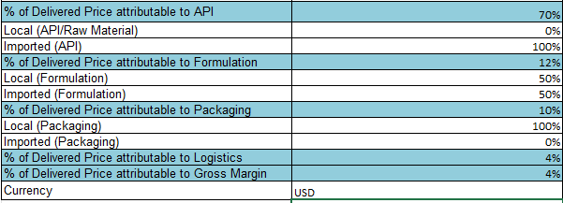
28
Offering a bid price
(Phase III evaluation) continue
Price breakdown
Example
Note: Please select the relevant currency by clicking on the dropdown arrow.

Slide 29
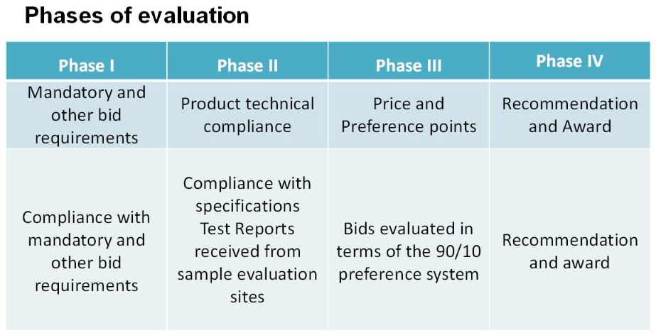
Phase III Evaluation
Evaluated as per the requirements stated in bid document & SRCC

Slide 30
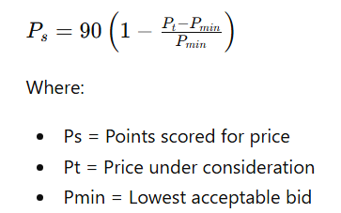
Phase III: Allocation of Price Points
A maximum of 90 points will be allocated for price.
Price points will be calculated using the formula prescribed by the Preferential Procurement Regulations, 2022.

Slide 31
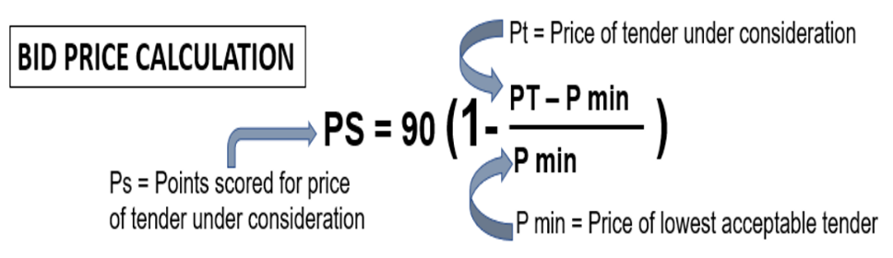
Points & Ranking of Bids Received - 90/10
Price (90 Points) + B-BBEE Status Level of Contributor (10 Points)
= Total Ranking Score
B-BBEE Status Level of Contributor (Max 10 Points)
TOTAL POINTS SCORED & DETERMINES RANKING OF BID
Notes:
Compliance to all specifications and regulations – all other bids prices measured against lowest and calculated accordingly, to obtain a score out of 90

Slide 32
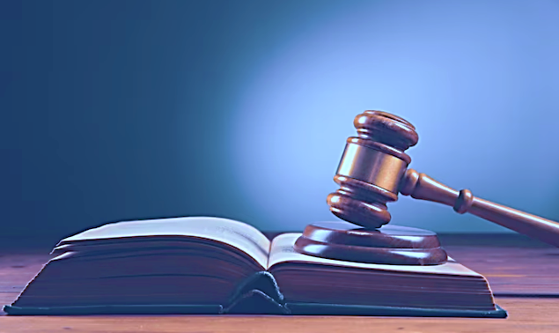
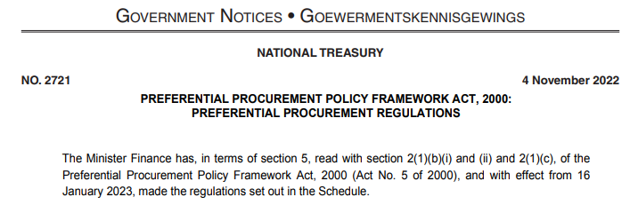
2022 Preferential Procurement Regulations
Placeholder for Public Procurement Bill / Public Procurement Act, 2024
Organs of State may select preference points allocations and select own specific goal/s within the framework of the Regulations.
A revised NDoH specific goal aligned with NDoH SCM Policy was introduced recently through a formal BEC process.is tender
Price and Preference points : 90/10
Points allocated for HDI equity ownership and South African ownership in bidding enterprise (supported by individual share certificates).
B-BBEE certificate not required - not used as a measurement tool
Specific goal applicable to this tender The promotion of companies with higher B-BBEE contribution levels (Status Levels 1-4), with preferential points allocated to B-BBEE (as reflected in Table 1 on SBD6.1 claim form)

Slide 33
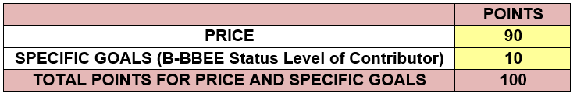
Phase III: Price and B-BBEE Preference Points
Evaluation
Responsive bids will proceed to Phase III evaluation after successful completion of:
Phase I Administrative Evaluation
Phase II Product Technical Evaluation
Price and Preference Points Evaluation
The 90/10 preference point system will be applied.
Points allocated as follows:

Slide 34
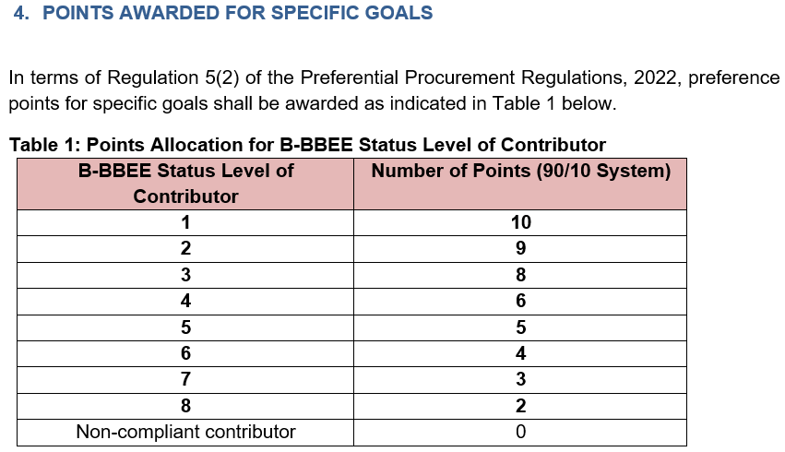
Phase III: Allocation of Preference Points
Allocation of Preference points will be allocated according to the bidder’s
B-BBEE Status Level of Contributor.
Very Important:
To claim (SBD6.1) B-BBEE preference points, bidders must submit:
Valid SANAS accredited B-BBEE Certificate
or
Valid EME Affidavit
or
Valid QSE Affidavit
Requirements:
Supporting evidence must be valid on bid closing date
Be issued in the name of the bidding entity
Bidder must indicate level and points claimed, and sign SBD6.1

Slide 35
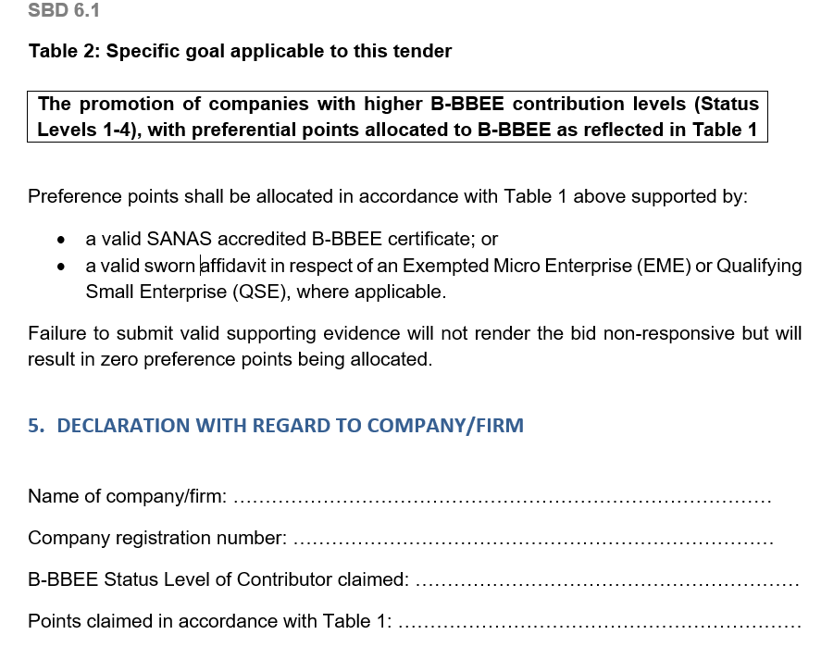
Phase III: SBD6.1 Claim form
POINTS CLAIMED
(See page 3 of 4 pages
Par 5 of SBD6.1 Form)

Slide 36
Phase III: Failure to Submit Valid B-BBEE Documents
❌ Failure to submit valid proof:
Does NOT make the bid non-responsive
However:
✔ Bid proceeds to evaluation
! Bid receives 0 preference points

Slide 37
Phase III: Multi-Entity Bids
Bids received from a multi-entity bidding enterprise where bidder is not the applicant, as per Section 7.13 and Section 9.4.
Preferential Points Claim Requirements:
Both bidder and applicant must submit:
B-BBEE Certificates or EME/QSE Affidavits
Preference points will be allocated:
Option 1
Based on agreed percentage contribution towards tender execution in the agreement
Option 2
If no percentage contribution is specified:
Lowest applicable B-BBEE score applies

Slide 38
Phase III: Bid Ranking
Total points determine ranking.
Highest total score = Highest ranked bidder
Evaluation Component | Maximum Points
Price | 90
B-BBEE | 10
Total | 100
Subject to:
  Responsiveness
  Technical compliance
  Objective criteria & award conditions (SRCC)

Slide 39
General Notes on claim submissions
Read the SRCC carefully
Be sure to complete each document very thoroughly
Submit appropriate supporting documents to substantiate any claim

Slide 40
40
Award conditions
  The National Department of Health reserves the right to:
  Award the same item as a multiple award to various suppliers (two or more) to address high volume requirements, security of supply and product availability.
  Negotiate prices and minimum order quantities and volumes.
  Award an item with a specification deviation.
  In cases where the tender does not achieve the most economically advantageous price, the National Department of Health reserves the right not to award that item.

Slide 41
41
Therapeutic Classes
  Therapeutic Classes refer to section 24.1 of the SRCC
  Therapeutic class is defined as a group of medicines which have active ingredients with comparable therapeutic effects. Medicines in a therapeutic class may or may not belong to the same pharmacological class, may differ in chemistry or pharmacokinetic properties, and may possess different mechanisms of action, result in different adverse reaction, have different toxicity, and drug interaction profiles.
  In most cases, these medicines have close similarity in efficacy and safety profiles, when administered in equipotent doses for a specific indication.
  Items that will be considered for award as a series refer to section 24.1 for the list of such items.

Slide 42
42
Therapeutic Classes
Source documents
The Policy for Classifying Medicines into Therapeutic Classes for Purposes of Therapeutic Interchange
https://www.health.gov.za/wp-content/uploads/2021/08/Therapeutic-Interchange-Policy_July2021_final.pdf
A single member of the class may be awarded.

Slide 43
43
Series Awards
  Series Awards refer to section 25 of the SRCC
Items will be awarded in a series where:
Dose titration is required e.g. a single molecule in a class is awarded across all strengths and pack sizes to allow for incremental dosing. Such an approach is required to ensure seamless dose titration, simplify supply and distribution, support healthcare worker use and acceptance, and improve patient adherence.
Items that will be considered for award as a series refer to section 25 for the list of such items.

Slide 44
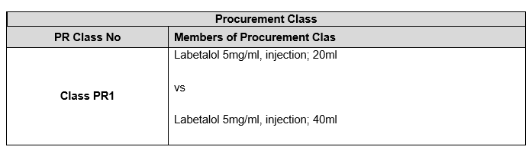
44
Procurement Class
  Procurement Class refer to section 26 of the SRCC
A procurement class is a grouping of medicines with the same active ingredient but different pack sizes, strengths, formulations, or dosage forms. It is used when market competition is limited, or specific product requirements are not clinically essential. Placing these items in a procurement class promotes fair comparison, competition, and economies of scale, while allowing flexibility to adapt to market availability and ensure continued access.
Only one item specification is awarded within a procurement class, though the award may be split between suppliers if needed. During price evaluation the cost per millilitre will be considered.

Slide 45
45
Award conditions continue
  The following are examples of considerations which may be considered when contemplating a multiple award:
Source of Active Pharmaceutical Ingredient (API) and actual manufacturing site;
Capacity to meet expected demand as per published estimates in the Excel Bid Response Document;
Estimated volume to be supplied;
Risk to public health if the item is not available;
Past compliance of the bidder with contractual obligations.

Slide 46
46
Contractual Price Adjustment (CPA) - Section 31 of the SRCC
    Only the portion of the bid price facing foreign exchange risk will be adjusted.
    Adjustments calculated using the original awarded contracted price as the base.
    The percentage change between a base average rate of exchange (RoE) and an adjustment average RoE.
    Rates are sourced from the Reserve Bank (www.resbank.co.za).
    Where no application for an adjustment relating to foreign exchange has been received and such an adjustment would be favourable to the Department, this will be implemented automatically.
    Foreign exchange adjustments may never result in a price exceeding the current Single Exit Price.
    Additional CPA at the start of the contract has been implemented please refer to the CPA Exceptional section 34.1 of the SRCC for further detail.

Slide 47
47
Offering a bid price
(Phase III evaluation) continue
Price breakdown
In order to be eligible for Contractual Price Adjustments all sections of the below example inclusive of currency must be completed.
Note: Please select the relevant currency by clicking on the dropdown arrow.

Slide 48
48
Lead times and Quantities
    Initial lead time
    This period may not exceed 75 calendar days from the date of award.
    NOT from the date of publication of the contract circular or 1st order received.
    Lead time
    (within the contract period)
    This lead time may not exceed 14
    calender days
    Quantities advertised = estimated volumes, not guaranteed.
    Fluctuations in monthly demand may occur.
    Proposed minimum order quantities should facilitate delivery directly to facilities.

Slide 49
49
Orders
    Only orders made on an official, authorised purchase order are valid.
    Suppliers are required to acknowledge receipt of all purchase orders received from participating authorities, in a manner stipulated by the relevant participating authority.
    Changes to any quantities ordered may only be made upon receipt of an amended purchase order.
    The Participating Authorities reserve the right to cancel orders where the lead time exceeds the delivery lead time specified in the contract.
    In cases where an order is received which appears to be irrational or misaligned with estimates, the contracted supplier must liaise with the relevant Participating Authority prior to processing the order.

Slide 50
50
Supplier Performance Management
    The National Department of Health, in collaboration with the Participating Authorities, will monitor the performance of contracted suppliers in terms of this contract, including but not limited to the following:
Compliance with delivery lead times;
Compliance with delivery in full as per the purchase order;
Percentage of orders delivered on time and in full;
Compliance with reporting requirements according to reporting schedule and reporting mechanism; and
Attendance of compulsory quarterly meetings
    Contracted Suppliers may be required to present continuous improvement initiatives aimed at improving efficiencies in the supply chain to benefit both suppliers and the Department

Slide 51
51
Supplier Performance Management
    Reporting requirements
As a minimum, suppliers will be required to submit the following:
All transactional data relating to orders;
A monthly age analysis;
Production pipeline data and forecast including:
  Number of units of the item available (stock on hand);
  Number of units of the item in Quality Assurance, awaiting release;
  Number of units of the item in the current month’s production plan.
  Status of outstanding orders.

Slide 52
52
Continuity of supply
Suppliers are required to maintain sufficient buffer stock to meet at least two months demand for all items, aligned with the needs of participating Authorities.
Allowances for a reduced yet appropriate buffer stock will be made for the last two (2) months of the contract as agreed upon between NDoH and the contracted supplier.
Contractors must inform the National Department of Health at first knowledge of any circumstances that may result in interrupted supply, including but not limited to:
regulatory action which may impact on their GMP status or that of entities on which they are reliant;
any anticipated problems associated with the availability of active pharmaceutical ingredient (API);
industrial action;
challenges with manufacturing pipeline;
any other supply challenges.

Slide 53
53
Continuity of supply
  Contracted Suppliers must direct official communication relating to continuity of supply to stockalert@health.gov.za, as well as Participating Authorities;
  All official communication must include detail of corrective actions taken by the contracted supplier to ensure continuity of supply.
  It is the responsibility of the contracted supplier to ensure continuous availability and supply of contracted items.
  If the contracted supplier is unable to supply, the contracted supplier will source alternative product of acceptable quality and up to the same quantity as required in terms of the contract.
  The substitute item will be supplied at the current price of the contracted item.

Slide 54
Continuity of supply as per updated SRCC
Supplier Inability to Supply (Less than 6 Months):
If a contracted supplier in a split/multiple award cannot supply an item for up to six months, the NDoH can reallocate volumes to another contracted supplier temporarily.
Supplier Inability to Supply (More than 6 Months):
If a supplier cannot supply an item for more than six months, the NDoH can cancel the contract as per Section 23 of the GCC (Clause 21.2).
Penalties for Delays: Suppliers may face penalties for exceeding the contractual lead time as per Section 22 of the GCC.
Procurement Outside the Contract: Participating Authorities can purchase outside the contract if the contracted item is not available within the 14-day lead time. The cost difference between the contracted supplier's item and the alternative item will be borne by the contracted supplier.

Slide 55
55
Shelf life
Unless MCC or SAHPRA, has approved a shorter shelf life, products must have a shelf-life of at least 12 months upon delivery.
  Contracted suppliers may apply in writing to PAs to supply a product with a shorter shelf life provided that:
  Applications are accompanied by an undertaking that such short-dated products will be unconditionally replaced or credited before or after expiry; and
  applications are approved before execution of orders; and
  upon notification of remaining expired stock such products will be collected by the supplier at their own cost; and
  failure to collect the products within 30 days after written notification to the supplier will result in the disposal of the product by the PA for the account of the supplier.
    Any PA may, without prejudice, decline to accept product with a shelf-life of less than 12 months.

Slide 56
56
Tips for Completing the Bid Document
  Bid Response Document - Adobe Reader 9 or later must be used.
  This is available as a free download.
  If you have difficulty in downloading / opening or saving documents, first try opening the document online then saving from there to your computer. Add your company name to filename
  Only start completing the document when downloaded and saved. Highlight existing fields to avoid missing any fields
  If your Adobe does not allow to complete electronically, complete the document by hand, using black ink.
  Fields can be corrected by overtyping – note that some fields could be “prefilled” from a previous entry
  Complete all fields, print and save, confirm correct, then complete any remaining empty fields, then sign and scan.
  Ensure that all fields in the final electronic copy correspond with the final printed copy (as latter is the legal bid)

Slide 57
57
Tips for Completing the Bid Document
  Excel Document
  Use Ms Excel® 2007 or later
Complete ALL response fields in Excel for items on which bids are submitted
Note carefully what unit is asked for: the estimates are expressed in these units
Submit price according to this unit Certain fields are restricted to numbers only to avoid you entering spaces, commas or letters DO NOT make any changes to item numbers, item specifications or estimates or add / duplicate columns
If you want to make additional offer on the same product, submit another Bid Response Document for that item – clearly naming it Alt_offer(s)

Slide 58
58
Final checks
  Finalizing bid document
Double-check :
Accuracy and completeness of the completed document.
All bid prices are for the correct unit and are VAT-inclusive.
Print out the BRD
Compare the printed BRD with the electronic version (Ensure that all items are printed - printed version is the legal copy)
Sign every page of hard copy
Save and submit electronic completed BRD in Excel on a USB as Set 3, and also;
Save and submit a PDF copy of the signed BRD on the USB as Set 2.
Submission of complete set at NDoH bid box (Site indicated in SBD1)
Bidders are strongly advised to complete the Bid Box Register when submitting their bid.

Slide 59
59
  Challenges found in previous tenders:
USB either corrupt or no data saved (Ensure to check that the data is available and accessible);
Certification of relevant documents was found to be copies and not dated (Ensure it is an original stamp from a Commissioner of Oath and dated);
Compulsory bid documents not signed, if signed a copy was submitted (Ensure compulsory documents are signed in black wet ink in spaces provided)
Bidders do not initial each page in black wet ink (Ensure to check the full bid documents prior to submission that all relevant initials and signatures required are present)
Submission of 3rd Party Authorisation letters as indicated on the Medicine Registration Certificate is compulsory (Please submit the relevant Authorisation. If it deviates from the MRC kindly provide a detailed explanation for the reasons thereof)
Submission of the MRC Variation Summary approved by SAHPRA amending changes on the MRC (MRC must be submitted to verify amendment)
Legible electronic copy of the Package insert as part of Set 2 is a requirement
Naming convention of the electronic files is not in accordance with Annexure A Checklist.
Incorrect MRC Certificate supplied in bid pack.
Licence to Manufacture omitted from bid pack.
Capacity calculation
Bid Response document not complete in full and accurately.

Slide 60



60
The centralised toll-free corruption hotline - 0800 701 701
Read more: http://www.southafrica.info/services/government/hotline-anticorruption.htm#.Vekno0YbJzA#ixzz3kkAPmrmo

Slide 61
61
Thank You
  Thank you for attending this Online Briefing Session
  The End
  Question can be emailed to tenders@health.gov.za

